Slide 1
BEYOND THE DOSE:
Safe Medication Handling, Waste Categories and Compliance
Nicole Barnett, PharmD, BCGP
Guardian Pharmacy Clinical Support Services

Slide 2
Disclaimer
The content contained in this presentation is provided only for informational purposes only. Guardian Pharmacy Services attempts to ensure that content is accurate and obtained from reliable sources but does not represent it to be error-free.
Information in this presentation should not be used to make medical decisions. The information on this presentation is not intended or implied to be a substitute for professional medical advice, diagnosis, or treatment. Always seek the advice of a physician or other qualified health provider with any questions you may have regarding a medical condition. Never disregard professional medical advice or delay in seeking it because of something you have read on this presentation.
Created and distributed by Guardian Pharmacy Services. Do not copy, publish, reproduce, perform, modify, create derivative works, transmit, or distribute without express permission by Guardian Pharmacy Services.

Slide 3
Disclosure
The speaker has NO relevant financial relationships with commercial interests and will not be discussing non-FDA approved uses of any drugs.
None of the planners for this activity have relevant financial relationships to disclose with ineligible companies.

Slide 4
Learning Objectives
Define and compare hazardous waste, pharmaceutical waste, hazardous drugs, non-hazardous drugs and controlled substances
Describe special handling and disposal for medications included in the categories listed above
Review the regulatory agencies responsible for oversight of proper handling and disposal of medications in long-term care communities

Slide 5
Important Abbreviations
USP = United States Pharmacopeia
NIOSH = National Institute for Occupational Safety and Health
FDA = Food and Drug Administration
OSHA = Occupational Safety and Health Administration
HD = Hazardous Drug
PPE = Personal Protective Equipment
AoR = Assessment of Risk
MSHI = Manufacturer’s Special Handling Information
EPA = Environmental Protection Agency
DEA = Drug Enforcement Administration
RCRA = Resource Conservation and Recovery Act
ASTM = American Society for Testing and Materials
Notes:
Add mshi

Slide 6
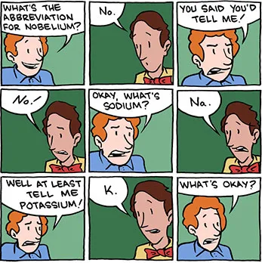

Slide 7
Define and Compare

Slide 8
WASTE
HAZARDOUS WASTE
HAZARDOUS WASTE PHARMACEUTICALS
Materials with properties that make them dangerous to human health or the environment
Defined by the EPA as:
  P-listed (acutely toxic)
  U-listed (toxic)
  Characteristic (ignitable, corrosive, reactive, toxic)
Includes Hazardous Waste Pharmaceuticals and Non-Pharmaceutical Hazardous Waste
Pharmaceuticals classified as hazardous waste per EPA
Considered hazardous when discarded
P-listed, U-listed, or characteristic
PHARMACEUTICAL WASTE
The broad umbrella for any unused medicinal product (expired, contaminated or otherwise meant for disposal)
Can be hazardous or non-hazardous
Notes:
P and U listed waste are pure or commercial grade formulations (known) that are unused
P listed are acutely toxic even at low doses (240 chemicals)
U listed are toxic but not as hazardous (just under 500 chemicals, 66 commonly found in healthcare)
A pharmaceutical is not a solid waste, as defined in § 261.2, and therefore not a hazardous waste pharmaceutical, if it is legitimately used/reused (e.g., lawfully donated for its intended purpose) or reclaimed.
Excluded: Not included within the scope of this definition are group homes, independent living communities, assisted living facilities, and the independent and assisted living portions of continuing care retirement communities. – Considered Household waste

Slide 9
Examples of Waste
HAZARDOUS WASTE
PHARMACEUTICAL WASTE
Chemical Cleaning Products
Pesticides/Herbicides
Acetone
Batteries
Aerosol/propellent
  Butane
  Propane
  Hydrofluorocarbons
    HFA
Non-Hazardous
  Over-the-Counter Meds
  Many Antibiotics
  Medications that don’t meet RCRA listed or characteristic for hazardous
Hazardous
  Epinephrine
  Warfarin
  Cyclophosphamide
Notes:
HFA stands for hydrofluoroalkane, a hydrofluorocarbon (HFC)

Slide 10
Check Point #1
TRUE or FALSE: Hazardous waste pharmaceuticals have been classified by the EPA as medications dangerous for human health and/or the environment.
Notes:
TRUE

Slide 11
Categories of Drugs
HAZARDOUS DRUGS
NON-HAZARDOUS DRUGS
CONTROLLED SUBSTANCE DRUGS
Occupational hazards
Defined by risk to the WORKER
NIOSH List 2024
Medications determined not to be hazardous to workers
Regulated by the DEA due to potential for abuse and dependence
May be identified as a hazardous drug
Exempt from hazardous waste pharmaceutical requirements

Slide 12
What makes a medication hazardous?
To be considered “hazardous” by NIOSH a drug must pose one of the following risks:​
Genotoxicity​: Impact or damage DNA/genes
Carcinogenicity​: Cause cancer
Teratogenicity or other developmental toxicity​
  Contribute to infertility
  Impact a developing embryo or fetus
  Cause developmental abnormalities
Cause organ damage
Similar structure or function that mimic other drugs known to be hazardous
Notes:
While the USP is the organization that determines the quality standards for handling hazardous medications, they are not the ones who determine whether or not a medication is deemed hazardous. The National Institute for Occupational Safety and Health, aka NIOSH, is responsible for this. If a medication carries warnings in its FDA labeling for any of these areas of concern, they can be found on this list.
​

Slide 13
Examples of Hazardous Drugs
NIOSH Table 1
Known to be a human carcinogen
NIOSH Table 2
Do not have MSHI or classifies as a human carcinogen
Arsenic
Azathioprine
Capecitabine
Cyclophosphamide
Methotrexate
Tamoxifen
Carbamazepine
Colchicine
Divalproex
Finasteride
Paroxetine
Warfarin

Slide 14
Check Point #2
A hazardous drug as defined by NIOSH has:
Been identified as P-listed or U-listed
Been determined to pose a risk to the healthcare worker
Been determined to be ignitable
Notes:
B

Slide 15
Special Handling and Disposal

Slide 16
HANDLING = worker safety
DISPOSAL = environmental safety and risk of contaminating water (waste)

Slide 17
USP800
Hazardous Drug Handling in Healthcare Facilities
USP<800> is one chapter of the USP standards
  Created based on a public health need
  Purpose is to protect healthcare workers and other patients who may be exposed to medications with hazardous properties
Chapter became enforceable on November 1, 2023
Refers to the NIOSH List (2024) to identify hazardous medications that require special handling as per USP standards
A site-specific Assessment of Risk for Table 2 hazardous drugs can be completed and is encouraged by NIOSH
Notes:
Healthcare workers in the U.S. handle an estimated 12 Billion doses of hazardous medications each year! Studies have indicated that repeated exposures could impact the HC workers own health, both acutely and potentially chronically. (Headaches, hair loss, nausea, kidney damage, cancer, infertility, other reproductive issues including effects on fetus or infants if breastfeeding.
Potential exposure to approximately 8 million U.S. healthcare workers each year

Slide 18
NIOSH List
Updated in 2024
  Categories
    Table 1 = Antineoplastic Drugs
    Table 2 = Non-antineoplastic hazardous drugs
      Includes identification of reproductive risk drugs if they meet the criteria for developmental and/or reproductive hazard
Notes:
Details on changes to the list:
2025-103.pdf = NIOSH List, 2024

Slide 19
Assessment of Risk
Evaluation of Table 2 hazardous drug risk to determine ALTERNATIVE containment strategies and/or work practices
Considers type of HD, dosage form, risk of exposure, packaging and manipulation
  Most medications given in LTCFs are on Table 2 of the NIOSH list
  Majority are not manipulated in any way and therefore poses minimal risk
If a risk assessment is NOT completed, full PPE must be donned for all levels of exposure risk
  Includes crushing medications, pouring liquids, splitting tablets, etc

Slide 20
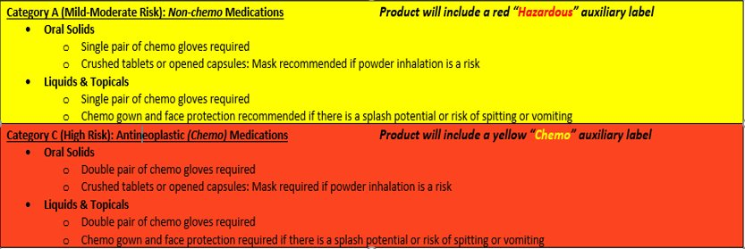
Hazardous Drug Handling per Risk Assessment

Slide 21
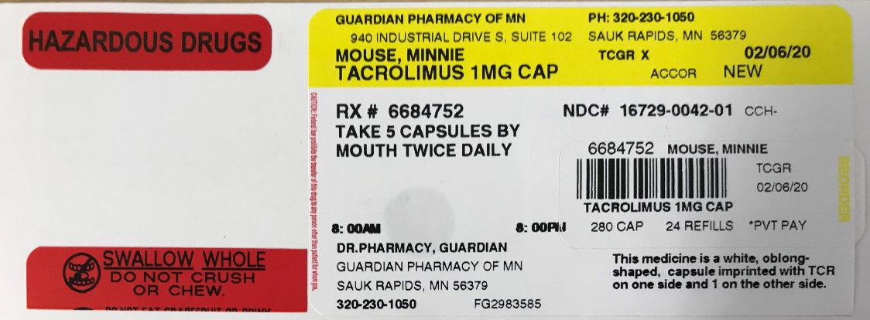
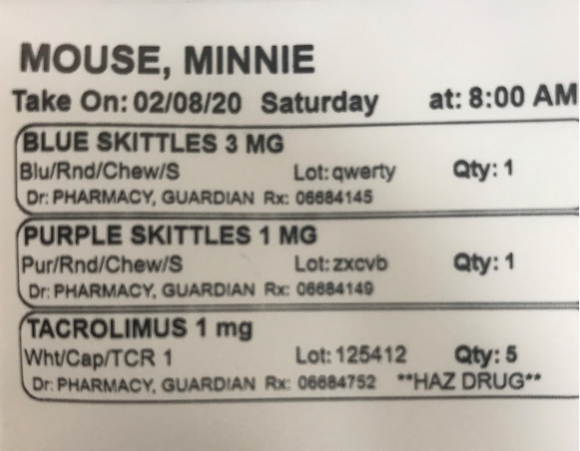
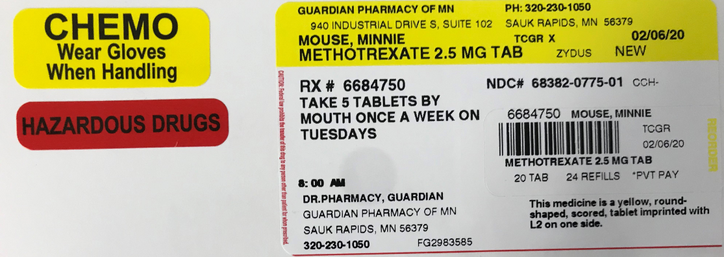
Identification of Hazardous Medications
A colorful auxiliary label
A notation on the printed prescription label
A notation on the MAR

Slide 22
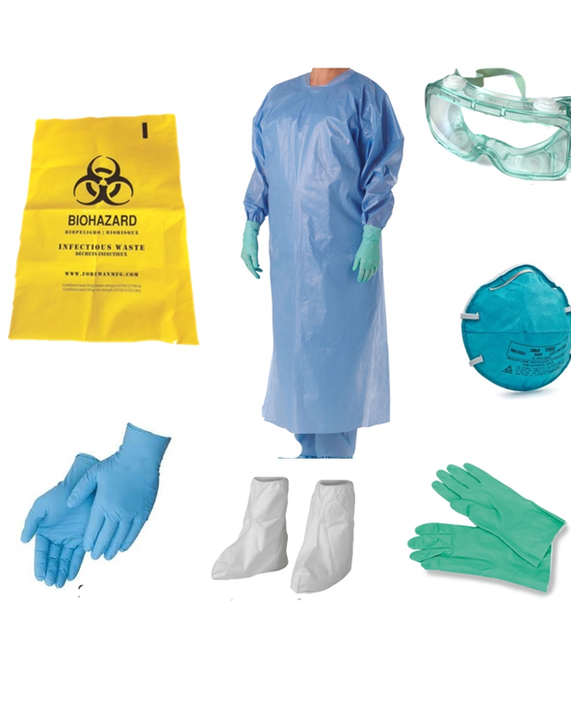
Personal Protective Equipment
The PPE needed will depend on the task being performed and the type of potential exposure:
Chemo Gloves*
Gowns
Goggles
N95 Respirator mask
Face shield
*Must be chemo gloves ASTM D6978 (or its successor) if no assessment of risk performed
Notes:
Most of you already have the PPE needed already in your buildings. Mainly it will be gloves, gowns, masks. Although, if manipulating Table 1 medications and skin contact or inhalation may be possible, it should be chemo-rated gloves and N95 masks.
And most of you already have in place devices like Silent Knights or RxCrushers, which are a mostly closed system for crushing medications.

Slide 23
Is PPE needed for every HD administered?​
NOT NECESSARILY ​
  Only if manipulation of the dosage form occurs
    Tablet splitting or handling cut tablets ​
    Opening a capsule​
    Crushing tablets ​
    Drawing up an injection​
    Pouring a liquid​
The main purpose of USP<800> is to protect employees who must handle HDs to ensure they have very minimal exposure
The resident or client taking the medication does not need protection ​
Handling should occur in a closed or isolated area to prevent ​exposure of other residents​
***Healthcare personnel should avoid manipulating HDs, such as crushing tablets or opening capsules if possible***

Slide 24
Containment Strategies
WHEN ARE FULL CONTAIMENT STRATEGIES NEEDED?
When manipulating meds on NIOSH Table 1 list
When compounding with any hazardous active pharmaceutical ingredient (API) – should not apply in LTCFs
If an assessment of risk was NOT performed
CONTAINMENT STRATEGY SHOULD MATCH THE RISK:
Administration of an oral solid tablet or capsule – no manipulation needed – poses minimal risk, really no risk if infection control policies are being followed
Crushing tablets and opening capsules – possible contact with skin, possible inhalation of dust
Liquids – potential for drips, spillage, or splashing
Creams – possible absorption through skin
Notes:
If following good infection control procedures, there will be no contact between the employee and the medication at all as the meds will be popped directly from the blister card to the souffle cup or from the med packet into the med cup
Some of you who use multi-dose packaging options may have noticed that the pharmacy no longer puts certain medications in those packages. The reason for that is because of this guidance. Because this type of packaging is automated, we cannot run the risk that a medication on Table 1 would be crushed in the process and then would potentially effect every other medication and packet in the machine. This would not only be a risk to our pharmacy team but also to all the other residents who get their medications in that type of packaging.

Slide 25
Check Point #3
If I am opening a capsule prior to administration of a hazardous drug and my facility has NOT completed an Assessment of Risk:
I can look up what PPE is required in a drug information resource
No PPE is required as the capsule is just being opened
Full PPE is required, same as what is needed for the highest risk level of exposure
Notes:
C

Slide 26

EPA Rule: Effective 2019
Bans disposal of hazardous waste pharmaceuticals down the drain, also known as “sewering”​
Reminder: Hazardous Pharmaceutical Waste is NOT the same as a Hazardous Drug in most cases​

Slide 27
EPA Rule
Skilled Nursing Facilities
Inpatient Hospice Facilties
Portions of Continuing Care Retirement Community
LTC Pharmacies
EPA Rule does NOT apply to INDEPENDENT LIVING or ASSISTED LIVING communities as waste is “household waste” in these settings.

Slide 28
Does the EPA Rule include Controlled Substances?​
NO!!!
Controlled Substances are EXCLUDED from the EPA Rule and fall to the DEA Final Rule (Title 21, Part 1317)​
  Cannot be returned to the pharmacy​
  Cannot be sewered or flushed​
  Must be rendered “not-retrievable”​
  Recommend use of a collection container (e.g. MedSafe) or chemical product (e.g. DrugBuster)​

Slide 29
Examples of Compliant Disposal Collection Systems
COLLECTION CONTAINER
  P- and U-listed Hazardous Waste Pharmaceuticals
  Controlled Substances
  Non-controlled substances
  OTC medications
Drugs destroyed using incineration to meet DEA non-retrievable standard
MedSafe
MAIL BACK PROGRAMS
  For individual “ultimate” users only
  Envelope to dispose of pharmaceuticals through DEA compliant mail program
    Household waste
  MED-Project
  Opioid Analgesic REMS
CHEMICAL PRODUCT
  Neutralizes medications on contact to meet
  Landfill friendly
  Discarded with common trash
  NOT to be used for disposal of hazardous waste pharmaceuticals
    Will need separate method of disposal (i.e., Stericycle or other medical waste services)
  RxDestroyer, Drug Buster
Notes:
MedSafe: Ultimate-user unused medication disposal system

Slide 30
Check Point #4
TRUE or FALSE: ALL medications can be disposed of using a commercial grade chemical solution.
Notes:
FALSE

Slide 31
Regulatory Oversight and Compliance

Slide 32

Occupational Safety and Health Administration (OSHA)
National Institute for Occupational Safety and Health (NIOSH)
Regulatory agency
Part of the Department of Labor
OSHA enforces the safety of the healthcare worker
Enforces use of PPE
Research agency
Part of the Department of Health and Human Services (CDC)
Provides scientific recommendations and best practices to improve worker safety
  Advises OSHA, recommendations tend to be stricter than what OSHA adopts as its minimum standard
List of drugs that may require additional PPE by the healthcare worker
Tests and approves PPE

Slide 33
FEDERAL AGENCIES
Environmental Protection Agency (EPA)
Drug Enforcement Agency (DEA)
Oversight of the “Closed System” of controlled substances.
Direct how to dispose of controlled substances
Independent regulatory agency
  Authority is granted by Congress
Writes specific rules and regulation to carry out the RCRA passed by congress
  Hazardous Waste Pharmaceuticals Rule (2019)

Slide 34
Reminder: Handling vs Disposal
Handling
  Follow USP800 quality standards
  Protect healthcare workers due to risk of exposure to hazardous drugs
Disposal
  EPA Rule for Hazardous Waste Pharmaceuticals that will no longer be used
  Protect the environment and human health by reducing hazardous pharmaceuticals from water systems
Hazardous drugs are NOT the same thing as Hazardous Waste Pharmaceuticals

Slide 35
Centers for Medicare and Medicaid Services (CMS)
Regulatory agency
Provides healthcare coverage for Medicare and Medicaid
SOM - Appendix PP includes regulations and surveyor guidance for proper handling, storage and disposal of medications

Slide 36
State Agencies
State Department of Health
State Board of Pharmacy
State Surveyors
Use SOM - Appendix PP during surveys which includes regulations and surveyor guidance for proper storage and disposal of medications
State Regulatory Agency
Regulates the interaction between the pharmacy and facility
  Emergency Kits
  Automated Dispensing Systems
  Pharmacy Services
State Environmental Agency
State regulatory agency
Enforcement of laws and regulations that protect the environment and public health within their borders

Slide 37
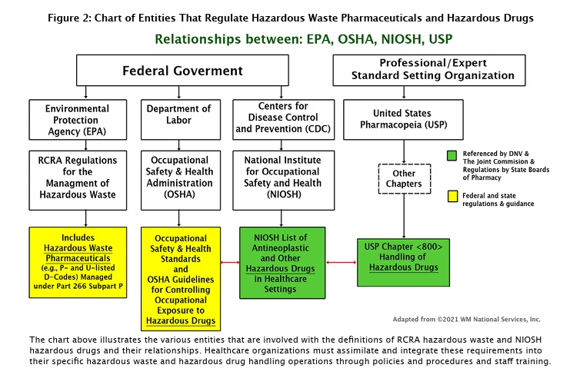
Source: 10 Step Blueprint For Managing Pharmaceutical Waste (funded by EPA)

Slide 38
Check Point #5
The following organizations ENFORCE the rules and regulations regarding proper handling and disposal of Hazardous Drugs and Hazardous Waste Pharmaceuticals:
NIOSH
OSHA
USP
EPA and DEA
B and D above
All of the above
Notes:
Answer: E

Slide 39
Questions?

Slide 40
References
Management of Hazardous Waste Pharmaceuticals | US EPA
About CMS | CMS
USP_HQS_800_FAQs_January2026.pdf
NIOSH List of Hazardous Drugs in Healthcare Settings, 2024| NIOSH | CDC
Managing Exposures to Hazardous Drugs: Information for Healthcare Settings | NIOSH | CDC
Regulated Medical Waste Disposal & Management | Stericycle
What To Do with Unwanted Household Medicines | US EPA
eCFR :: 21 CFR Part 1317 Disposal of Controlled Substances

