Slide 1
5/8/26
An Age Friendly Approach to Diabetes Care
Naushira Pandya, MD CMD FACP Professor and Chair
Department of Geriatrics Nova Southeastern University
Kiran C Patel College of Osteopathic Medicine
1
Disclosures
Naushira Pandya does not have relevant financial relationships with ineligible companies.
2

Slide 2





5/8/26
Learning objectives
Review of ADA 2026 goals of care in older adults
What Matters most; approach to rethinking goals and realigning care Medication management; safety and reduction of treatment burden Impact of diabetes on Mobility
Bidirectional impact of diabetes on Mentation
3
Older adults with diabetes:
A large and heterogeneous population
20% of people ≥65 years of age, and >30-35% of PALTC residents have diabetes
Highly heterogeneous population
  Clinical characteristics
  Self-care abilities and/or support system
  Goals and priorities
  Living situations and site capabilities
IDF Diabetes Atlas, 10th Edition. 2021.
Munshi M, Kahkoska AR, Neumiller JJ, et al. Lancet Diabetes Endocrinol 2025 Feb 17; PMID: 39978368.
4
4

Slide 3

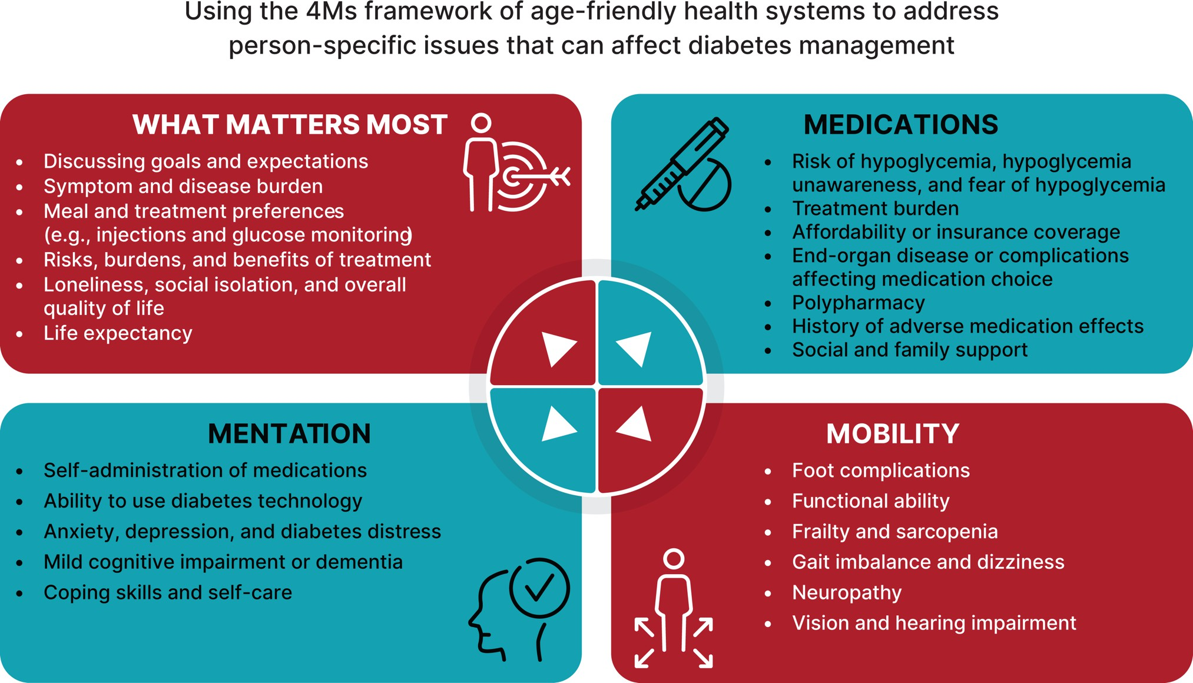
5/8/26
From: 13. Older Adults: Standards of Care in Diabetes—2026
Diabetes Care 1 January 2026; 49 (Supplement_1): S277–S296. https://doi.org/10.2337/dc26-S013
5
A complex patient of mine; Mr. AC
A 75 yr-old retired engineer with type 2 diabetes for 30 years. Recent gastric ulcer requiring transfusion
Complications: CAD, CABG, PAD with stents, neuropathy, R forefoot amputation, CKD2 A3
Medications: Glargine 19U Ǫ am, irbesartan 300 mg, rosuvastatin 10mg, apixaban 5mg, diltiazem ER 120mg
Physical exam: 128/76. Frail, pale, irregular rhythm, R forefoot amputation, neuropathy, absent pulses L foot and R posterior tibial
Laboratory tests: A1C 4.9%,EGFR 78, UACR 641 /min/1.73m^{2,} LDL 78mg/dL, Hb 8.9 g/dL
6

Slide 4
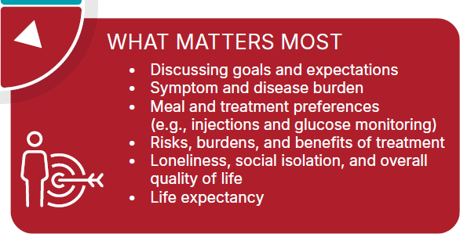
5/8/26
AR 1; What is the main clinical concern at this point for Mr. AC?
A. CKD A3 B.
C. Peripheral arterial disease
D. Heart failure
Hypoglycemia with unawareness
7
8

Slide 5
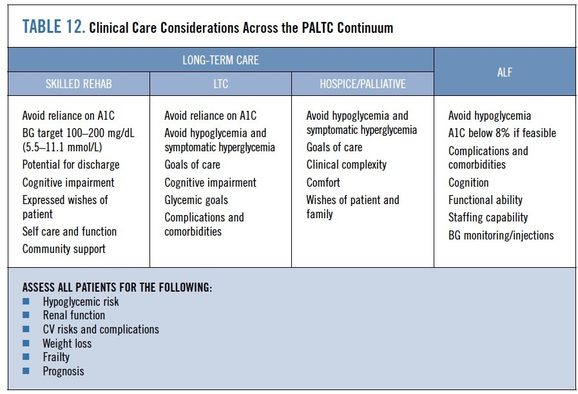
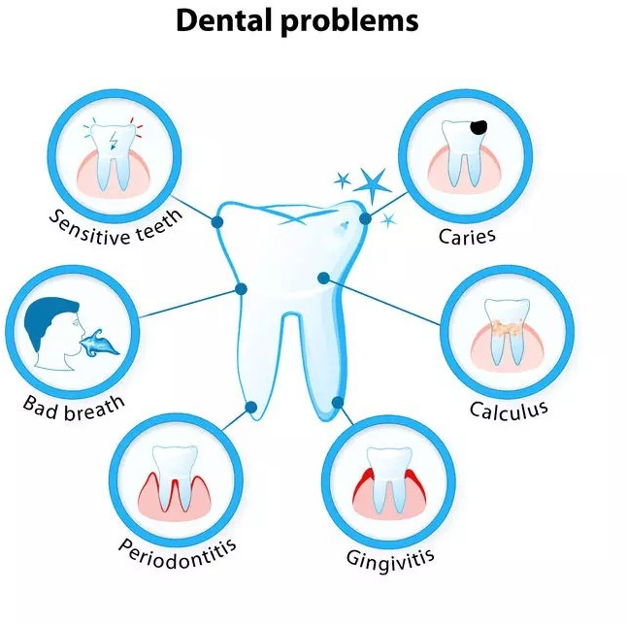
5/8/26
Davidson, H. E., Pandya, N et al
(2024). Clinical practice guideline for
diabetes management in the post-acute and long-
term care
setting. Journal of
the American Medical Directors Association, 25(11),
105342.
9
Dental Care
People with diabetes should be referred for a dental exam at least once per year. E
Coordinate efforts between the medical and dental teams to appropriately adjust glucose-lowering medication and treatment plans prior to and in the post-dental procedure period as needed. B
https://professional.diabetes.org/standards-of-care
10
10

Slide 6
5/8/26
Diabetes and Oral Health
Bidirectional relationship between type 2 diabetes and periodontal disease
Improved engagement in toothbrushing behavior may be associated
with improved oral health and better glycemic control in people with
type 2 diabetes
The proportion of US adults with diabetes seeing a dentist in the past
year was significantly lower compared to those without diabetes
(56.7% vs. 65.4%) .
While most patients knew good oral health practices, only a minority
followed them
Provider support was low; a minority (<30%) discussed oral health
practices with half or more of patients
Relationship between periodontitis and diabetes related kidney
disease
Ruth D. Lipman, Kelly K. O’Brienet al Diabetes Spectr 1 November 2023; 36 (4): 364–372 D Zeimer et al; 662-P: Diabetes 1 June 2020; 69 (Supplement_1): 662–P.
Diabetes 1 June 2020; 69 (Supplement_1): 558–P.
11
11
End-of-Life Care
13.18 When palliative care is needed, health care professionals should initiate conversations with people with diabetes and their care partners regarding the goals and intensity of care. Strict glucose and blood pressure management are not necessary, and simplification of medication plans can be considered, and withdrawal of lipid-lowering therapy may be appropriate. E
131G Prioritize the overall comfort, prevention of distressing symptoms, and preservation of quality of life and dignity as primary goals for diabetes management at the end of life. C
American Diabetes Association Professional Practice Committee for Diabetes*; 13. Older Adults: Standards of Care in Diabetes— 2026. Diabetes Care 1 January 2026; 49 (Supplement_1): S277–S296
12
12

Slide 7
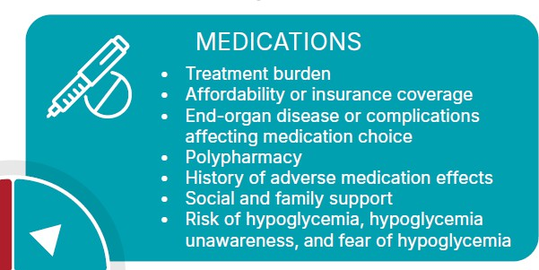
5/8/26
1. A stable individual: Continue with the person’s previous medication plan, with a focus on
prevention of hypoglycemia
management of hyperglycemia using blood glucose monitoring keeping levels below the renal threshold of
glucose, and hyperglycemia-mediated dehydration.
there is no role for A1C monitoring.
An individual with organ failure: Preventing hypoglycemia is of greatest significance.
  dehydration must be prevented and treated.
  in people with type 1 diabetes, reduce insulin as intake of food decreases, DO NOT STOP
  for people with type 2 diabetes, agents that may cause hypoglycemia should be reduced in dose
  allow for glucose values in the upper level of the desired goal range.
3. A dying individual: Discontinuation of medications
for people with type 2 diabetes, the discontinuation of all medications may be reasonable as they are unlikely
to have any oral intake
in people with type 1 diabetes, there is no consensus, but a small amount of basal insulin may prevent acute hyperglycemic complications
American Diabetes Association Professional Practice Committee for Diabetes*; 13. Older Adults: Standards of Care in Diabetes—2026.
Diabetes Care 1 January 2026; 49 (Supplement_1): S277–S296
13
13
14

Slide 8
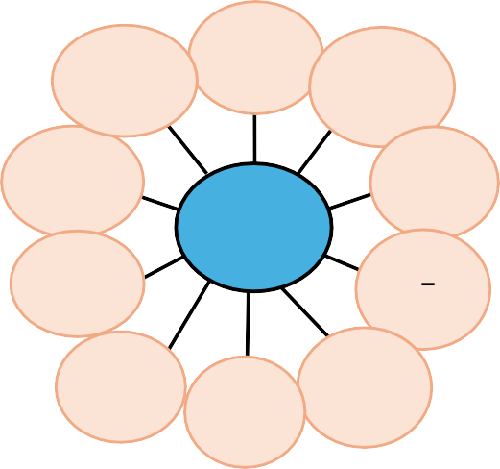
5/8/26
Risk factors for hypoglycemia
Peripheral neuropathy
Long duration of diabetes
History of hypoglycem ia and impaired awareness
Extensive comorbidities
Presenting symptoms may be neuroglycopenic rather than adrenergic
Social, Cultural, Economic
Medications/ Sulfonylurea/ insulin
Missed/
Hypoglycemia
Age > 75 Female sex
irregular meals/
Cognitive
physical CKD or End Stage
dysfunction,
activity Renal disease ^{Depression}
CVD = cardiovascular disease; VD = vascular disease.
Ahrén B. Vasc Health Risk Manag. 2013:9:155–163. Abdelhafiz AH, et al. Aging Dis.,2015;6(2):156–67.
15
15
Hypoglycemia in older adults
Older adults may be at higher risk:
  Irregular meal intake
  Insulin deficiency (absolute or relative) requiring insulin
  Impaired kidney function, comorbidities and complications
Hypoglycemia risk increases with greater intensity and complexity of the glucose- lowering regimen (especially sulfonylureas and insulin)
Increased glycemic variability (not necessarily low A1C) ↑ hypoglycemia risk
  Role of diabetes technology
Hypoglycemia Cognitive Impairment
Munshi M, Kahkoska AR, Neumiller JJ, et al. Lancet Diabetes Endocrinol 2025 Feb 17; PMID: 39978368. ADA Professional Practice Committee. Diabetes Care 2025;48(Suppl. 1):S266-S282.
McCoy RG, et al. BMJ Open Diabetes Res Care 2020;8(1):e001007.
16
16

Slide 9

5/8/26
Hypoglycemia-stronger recommendations for CGM
  Ascertain and address episodes of hypoglycemia at routine visits because older adults with diabetes have a greater risk of hypoglycemia, especially when treated with hypoglycemic agents (e.g., sulfonylureas, meglitinides, and insulin). B
  Recommend continuous glucose monitoring (CGM) for older adults with type 1 diabetes A and type 2 diabetes on insulin therapy B to improve glycemic outcomes, reduce hypoglycemia, and reduce treatment burden.
  Consider the use of automated insulin delivery systems B and other advanced insulin delivery devices such as connected pens E to reduce risk of hypoglycemia for older adults, based on individual ability and support system.
17
17
Education and Evaluation for use of Diabetes Technology in PALTC
13.18 Recommend diabetes education/training (including that for CGM devices, insulin pumps, and advanced insulin delivery systems) for the staff of long-term care and rehabilitation facilities to improve the management of older adults with diabetes. E
13.1G People with diabetes residing in long-term care facilities need careful assessment of mobility, mentation, medications, and management preferences to establish individualized glycemic goals and to make appropriate choices of glucose-lowering agents and devices (including CGM devices, insulin pumps, and advanced insulin delivery systems) based on their clinical and functional status. E
Practitioners and nursing leadership need training in interpretating CGM reports, responding to alarms
and glucose trends, and documenting in the medical record
Older Adults: Standards of Care in Diabetes—2026.
Diabetes Care 1 January 2026; 49 (Supplement_1): S277–S296
18
18

Slide 10
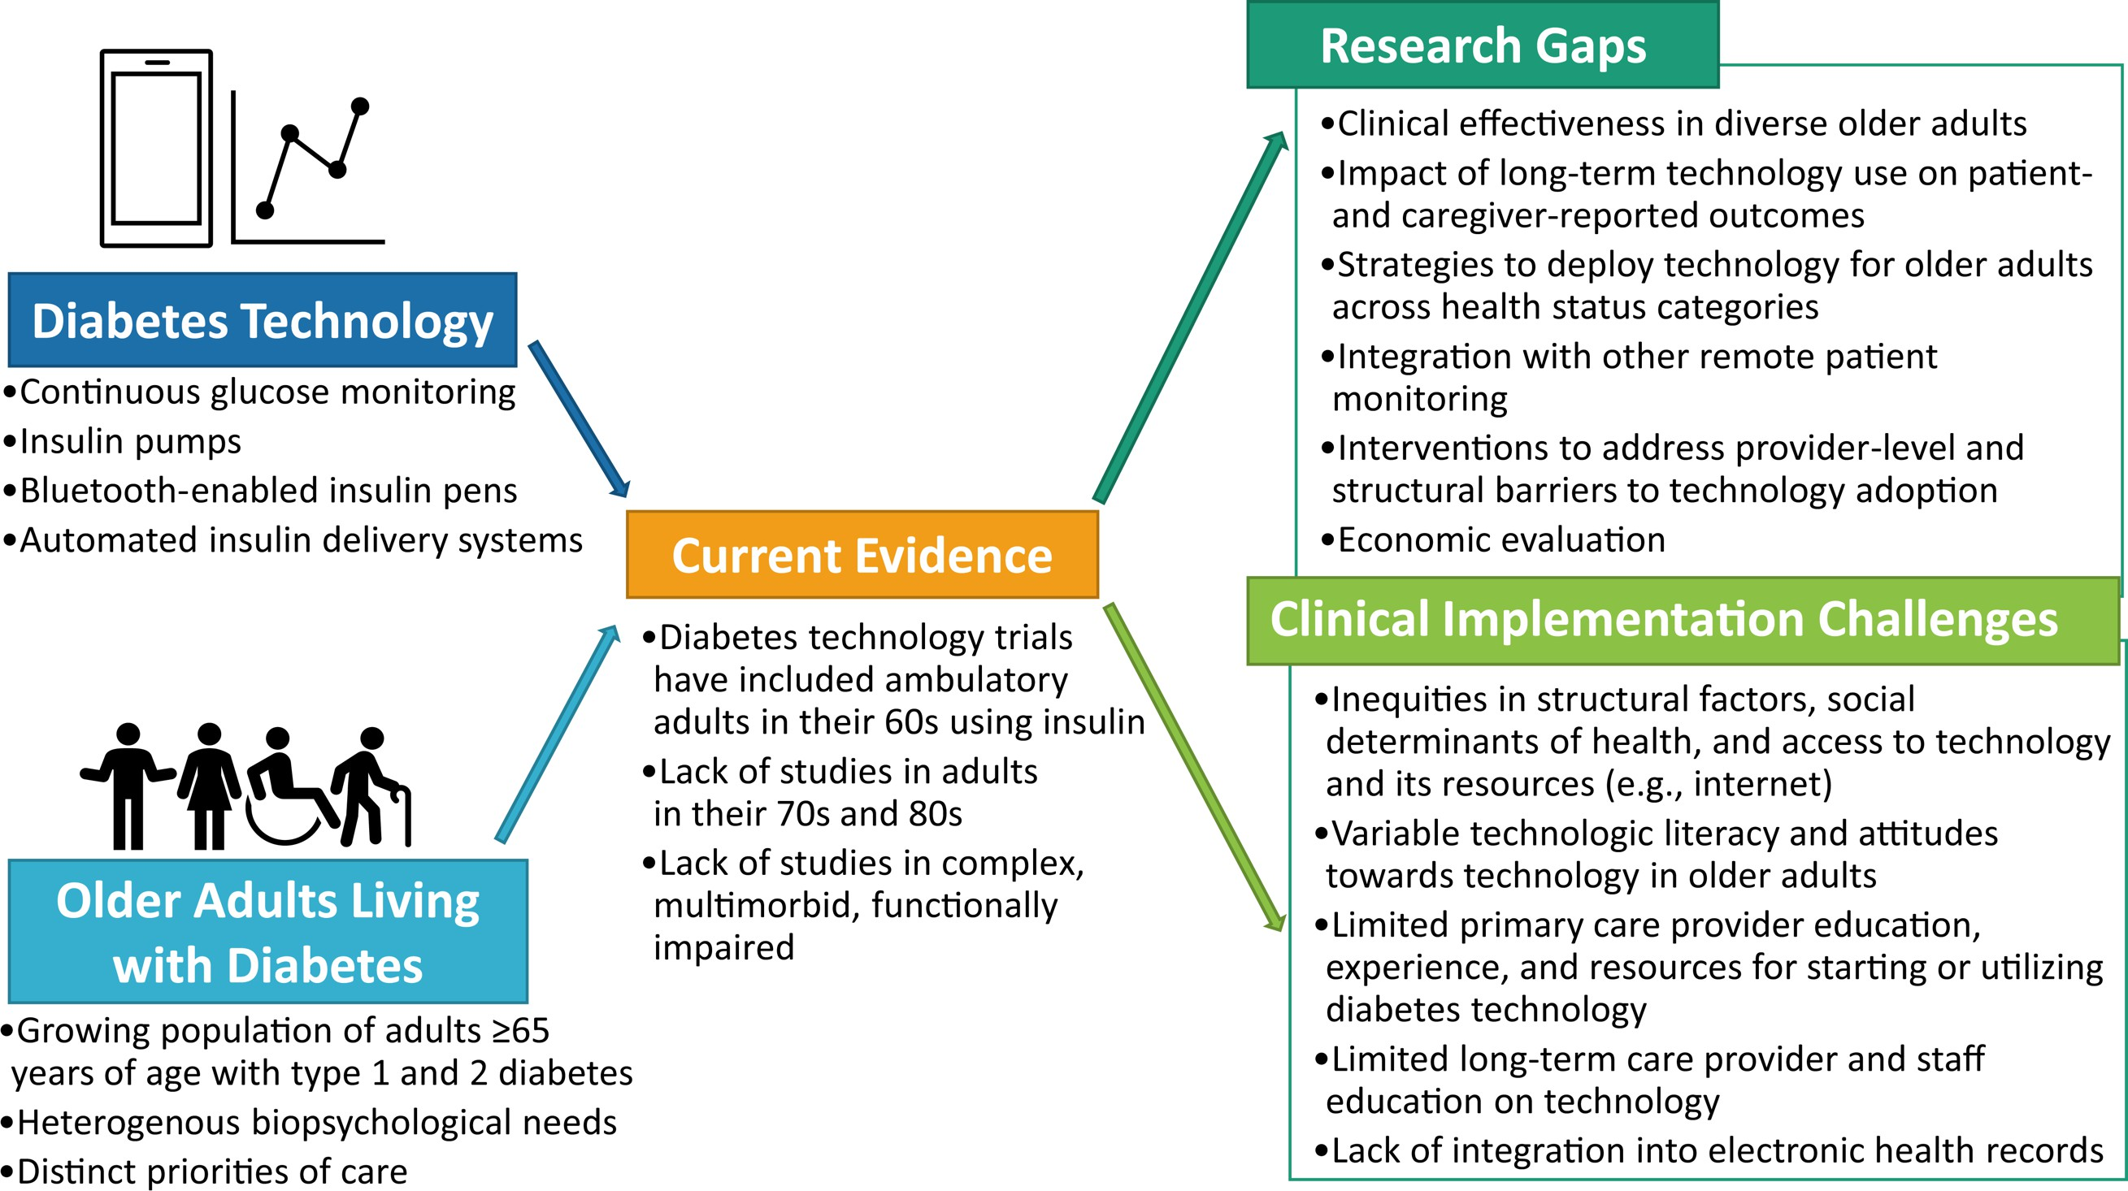
5/8/26
The Growing role of Technology in the care of older adults with diabetes. Elbert S. Huang, Alan Sinclair, Paul R. Conlin, et al (IGDS). Diabetes Care 1 August 2023; 46 (8): 1455–1463. https://doi.org/10.2337/dci23-0021
19
What do we know already about CGM?
DIAMOND trial (T1 and T2 D)- 0.4% reduction in HbA_{1c}, a reduction in glycemic variability and time
spent >250 mg/dL, and an increase in TIR compared with the BGM arm
WISDM trial (T1D)- 90% reduction in incident severe hypoglycemic events; reduction in the
incidence of BG values below 70 mg/dL and below 54 mg/dL as well as a reduction in BG values
above 300 mg/dL and an increase in TIR.
CGM can detect hypoglycemia, <70 mg/dL (40.2% vs 14%), and <54 mg/d (21% vs 1%) and
hyperglycemia >250 mg/dL (77% vs 56%) more frequently that POC monitoring CGM-Guided Insulin
Administration in Long-Term Care Facilities: A Randomized Clinical Trial Idrees, Thaer et al. JAMDA, Volume 25,Issue 5, 884 - 888
CGM is acceptable in dementia patients (usability, comfort, and helpful for care partners (N=12)
Mattishent, K., Lane, K., Salter, C., Dhatariya, K. et al (2019). CGM in older people with diabetes and memory problems: a mixed-methods
feasibility study in the UK. BMF open, S(11), e032037.
The use of rtCGM is safe and effective in guiding insulin therapy in patients with T2D in LTCF
resulting in a similar improvement in glycemic control compared to POC-guided insulin
adjustment. Continuous Glucose Monitoring-Guided Insulin Administration in Long-Term Care Facilities: A Randomized Clinical Trial Idrees, Thaer et al. JAMDA, Volume 25, Issue 5, 884 - 888
20

Slide 11
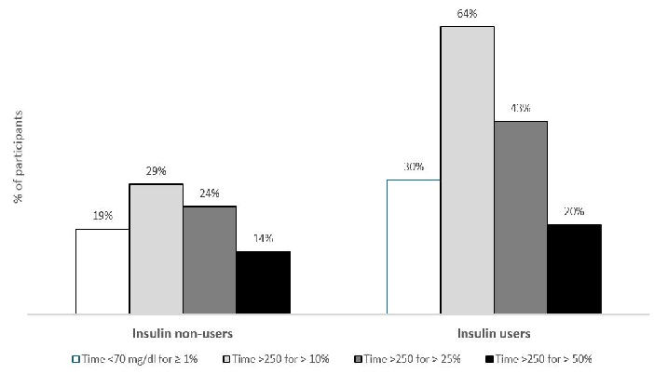
5/8/26
Excessive burden of hyperglycemia along with hypoglycemia in long term care facilities identified by continuous glucose monitoring
Masked CGM study in 8 midwestern nursing homes in 65 residents
Mean age 65y
68% of the cohort used insulin 64% was on non-insulin agents (11% on sulfonylurea).
Munshi, M. N., Slyne, C., Adam, A., Krakoff, N.,
Brabant, H., Savory, M., ... & Toschi, E. (2025). Journal of the American Medical Directors Association, 26(6), 105590.
21
Pharmacologic Therapy
  Select medications with low risk of hypoglycemia specifically for those with hypoglycemia risk factors. B
  Overtreatment of diabetes is common in older adults and should be avoided. B
  a Deintensify hypoglycemia-causing medications (e.g., insulin, sulfonylureas, or meglitinides) or switch to a medication class with low hypoglycemia risk for individuals who are at high risk for hypoglycemia, using individualized glycemic goals. B
13.16b Deintensify diabetes medications for individuals for whom the harms and/or burdens of treatment may be greater than the benefits, within individualized glycemic goals. E
Older Adults: Standards of Care in Diabetes—2026.
Diabetes Care 1 January 2026; 49 (Supplement_1): S277–S296
22
22

Slide 12
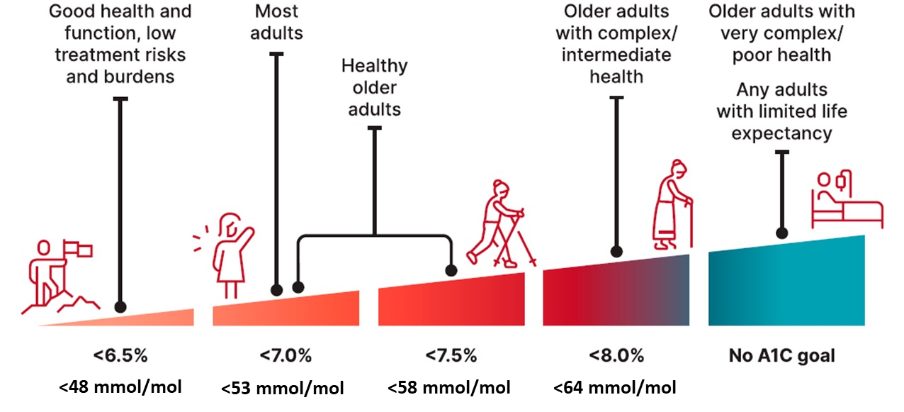
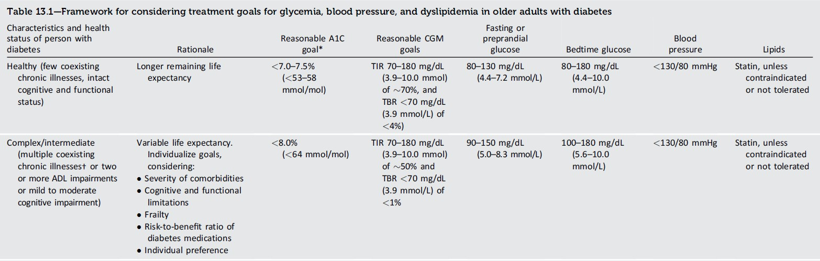
5/8/26
Individualization is important;
No universal threshold for “overtreatment”
, Kahkoska AR, Neumiller JJ. Lancet Diabetes Endocrinol 2020;8(2):65-87.
ADA; 13. Older Adults: Standards of Care in Diabetes—2025. Diabetes Care 1 Januauary
23
23
Older Adults:
Standards of Care in Diabetes - 2026 Diabetes Care 2026;49(Suppl. 1):S277-S296
24
24

Slide 13
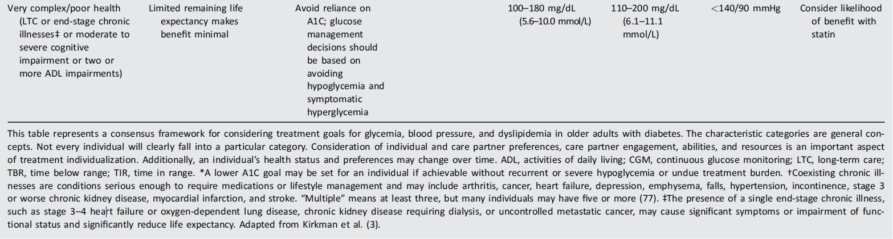
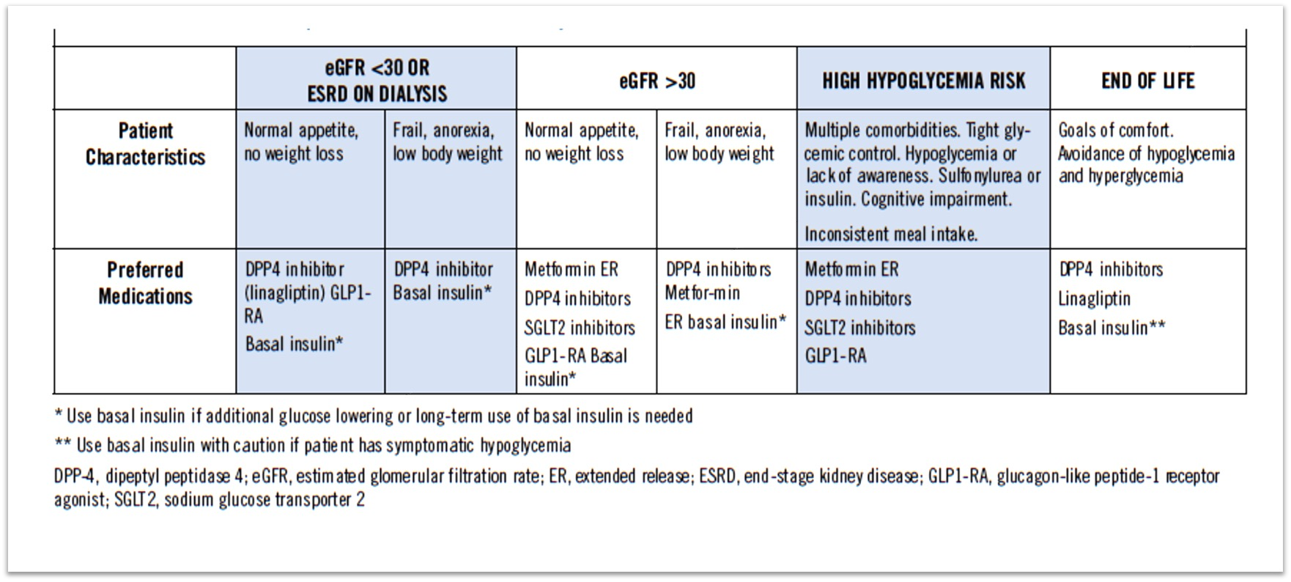
5/8/26
25
Older Adults:
Standards of Care in Diabetes - 2026 Diabetes Care 2026;49(Suppl. 1):S277-S296
25
Guidance on Optimal Medication Selection by Clinical Criteria
Davidson, H. E., Pandya, N et al (2024). Clinical practice guideline for diabetes management in the post-acute and long- term care setting. Journal of the American Medical Directors Association, 25(11), 105342.
26
26

Slide 14
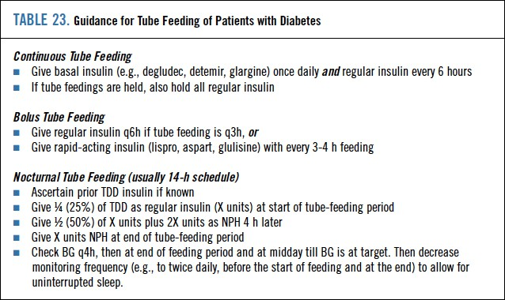
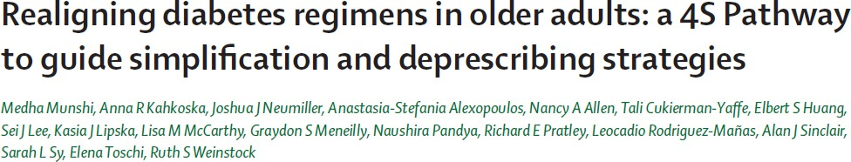
5/8/26
27
Munshi M, Kahkoska AR, Neumiller JJ, et al. Lancet Diabetes Endocrinol 2025 Feb 17; PMID: 39978368.
28
28

Slide 15
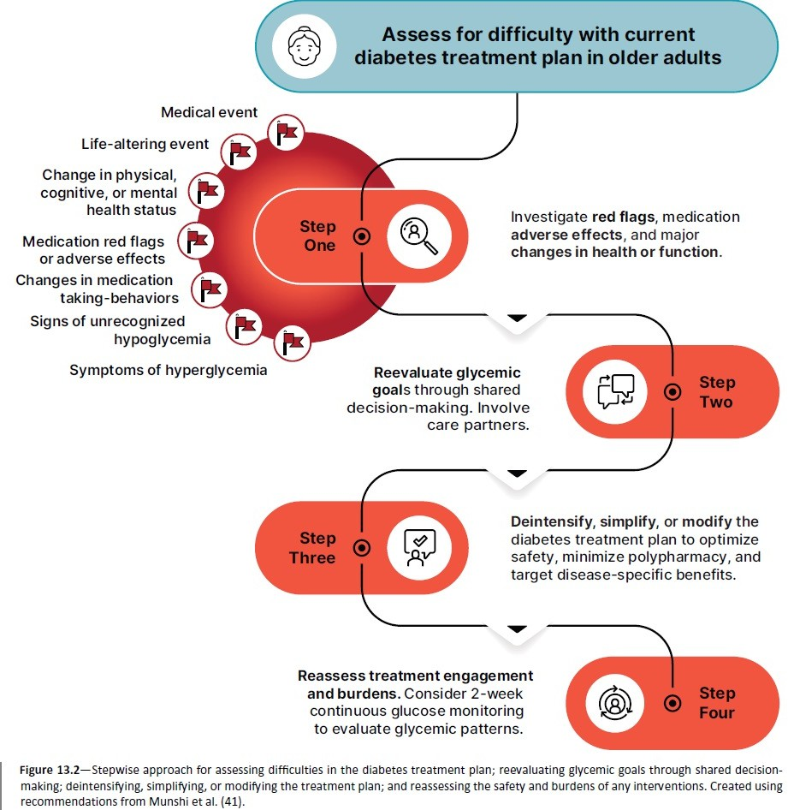

5/8/26
Figure 13.2
Older Adults:
Standards of Care in Diabetes - 2026 Diabetes Care 2026;49(Suppl. 1):S277-S296
29
29
Example triggers that may signal a need for re-alignment
Medical events
  Fall/accidental injury
  Emergency services call
  ED visit(s)
  Hospitalization
Life-altering events
  Change in living situation
  Death of a spouse
  Loss of care partner
  Change in financial situation
Change in physical, cognitive, or mental health status
  New or worsening frailty
  New diagnosis, disability or comorbidity (e.g., kidney disease)
  New or worsening cognitive impairment
  New-onset depression, anxiety, stress, or substance use
Munshi M, Kahkoska AR, Neumiller JJ, et al. Lancet Diabetes Endocrinol 2025 Feb 17; PMID: 39978368.
30
30

Slide 16
5/8/26
A complex patient of mine; Mr. AC
A 75 yr-old retired engineer with type 2 diabetes for 30 years. Recent gastric ulcer requiring transfusion
Complications: CAD, CABG, PAD with stents, neuropathy, R forefoot amputation, CKD2 A3
Medications: Glargine 19U Ǫ am, irbesartan 300 mg, rosuvastatin 10mg(recent addition), apixaban 5mg, diltiazem ER 120mg
Physical exam: 128/76. Frail, pale, irregular rhythm, R forefoot amputation, neuropathy, absent pulses L foot and R posterior tibial
Laboratory tests: A1C 4.9%,EGFR 78, UACR 641 /min/1.73m^{2,} LDL 78mg/dL (prior to statin), Hb 8.9 g/dL
31
AR 2:Besides reducing the insulin dose, how can we mitigate his risk of severe hypoglycemia?
Discuss harms of hypoglycemia, and reassess A1C goals
Order a continuous glucose monitor
Stop insulin glargine
Reassess the validity of his A1C measurement
** all correct but would be interesting to see the emphasis that the audience places on each option
32

Slide 17
5/8/26
What’s in a number?
Interpretation of A1C
A1c may be increased by
Hypothyroidism
Splenectomy
Aplastic anemia
Iron deficiency
A1C may be decreased by
Anemia
Blood loss, transfusions
Abnormal Hb (spurious)
Hemodialysis and Hct <30%
Liver disease
Race
C. Kim et al. Diabetes Care April 2010 vol. 33 PeacocK et al. Kidney International (2008) 73
33
33
AR 3: What medication change may be beneficial in view of his current complications?
A. Increase the dose of rosuvastatin
B. Change irbesartan to lisinopril C.
D. No change; monitor and follow-up in 3 mth
Add an SGLT2 inhibitor
34

Slide 18
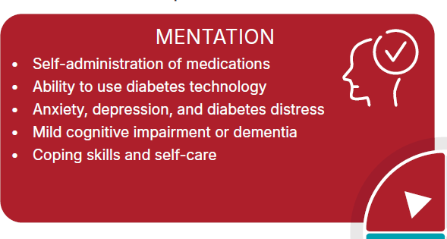
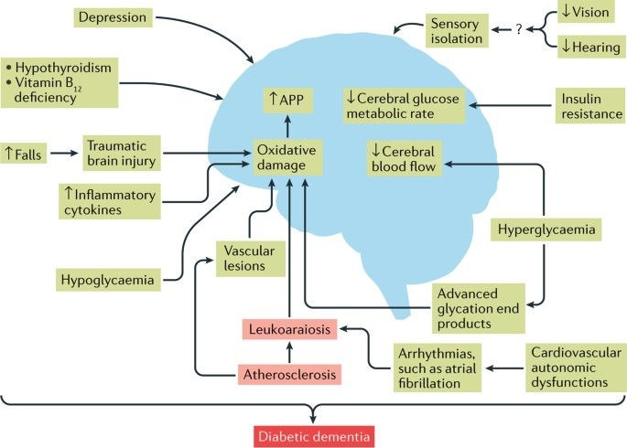
5/8/26
35
Diabetes and the brain
Morley, J. The diabetic brain. Nat Rev Endocrinol 13, 570–571 (2017). https://doi.org/10.1038/nrendo.
Diabetes can affect brain structure and function and lead to significant changes in cognition and behavior
Stroke risk is increased 2-fold
Depression increases by 60%
Anxiety increased due to fear of hypoglycemia, management stress, fear of long-term complications
36

Slide 19
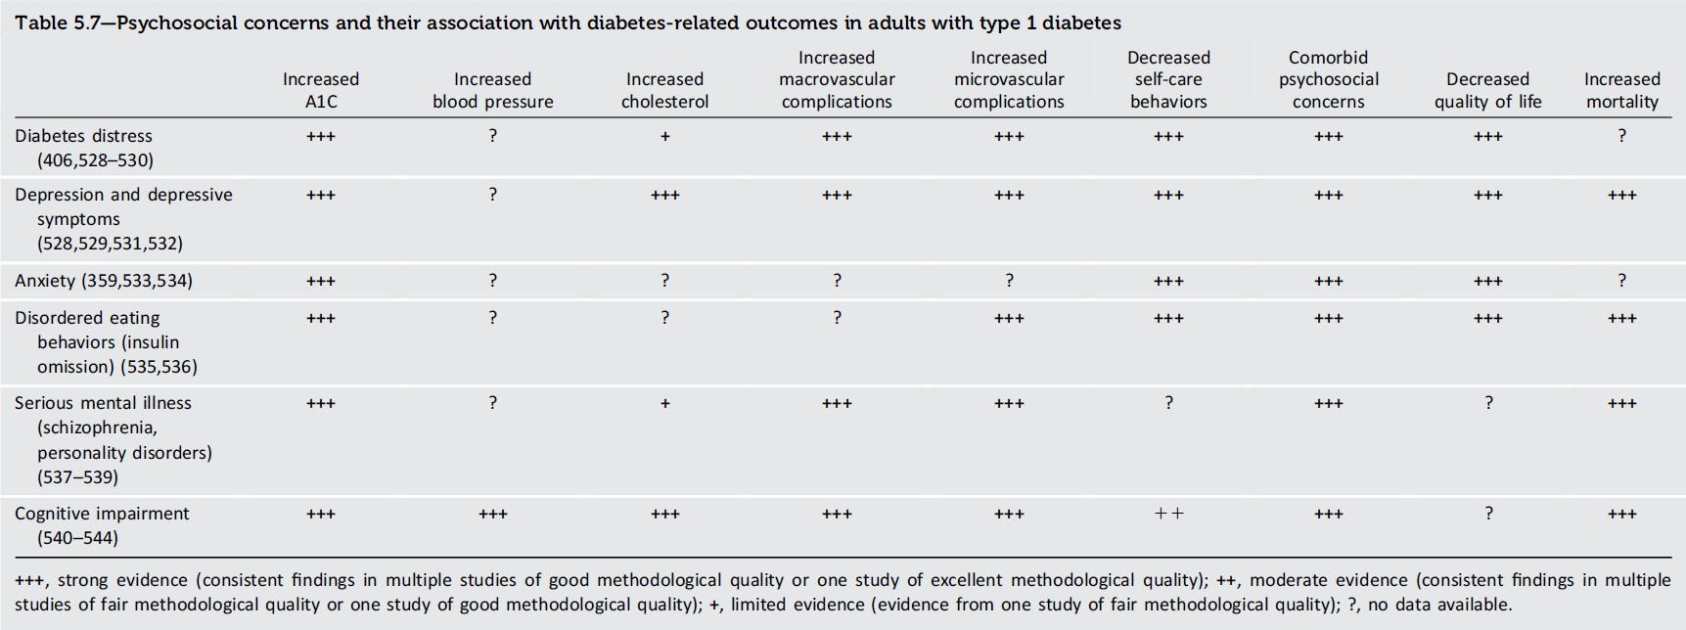
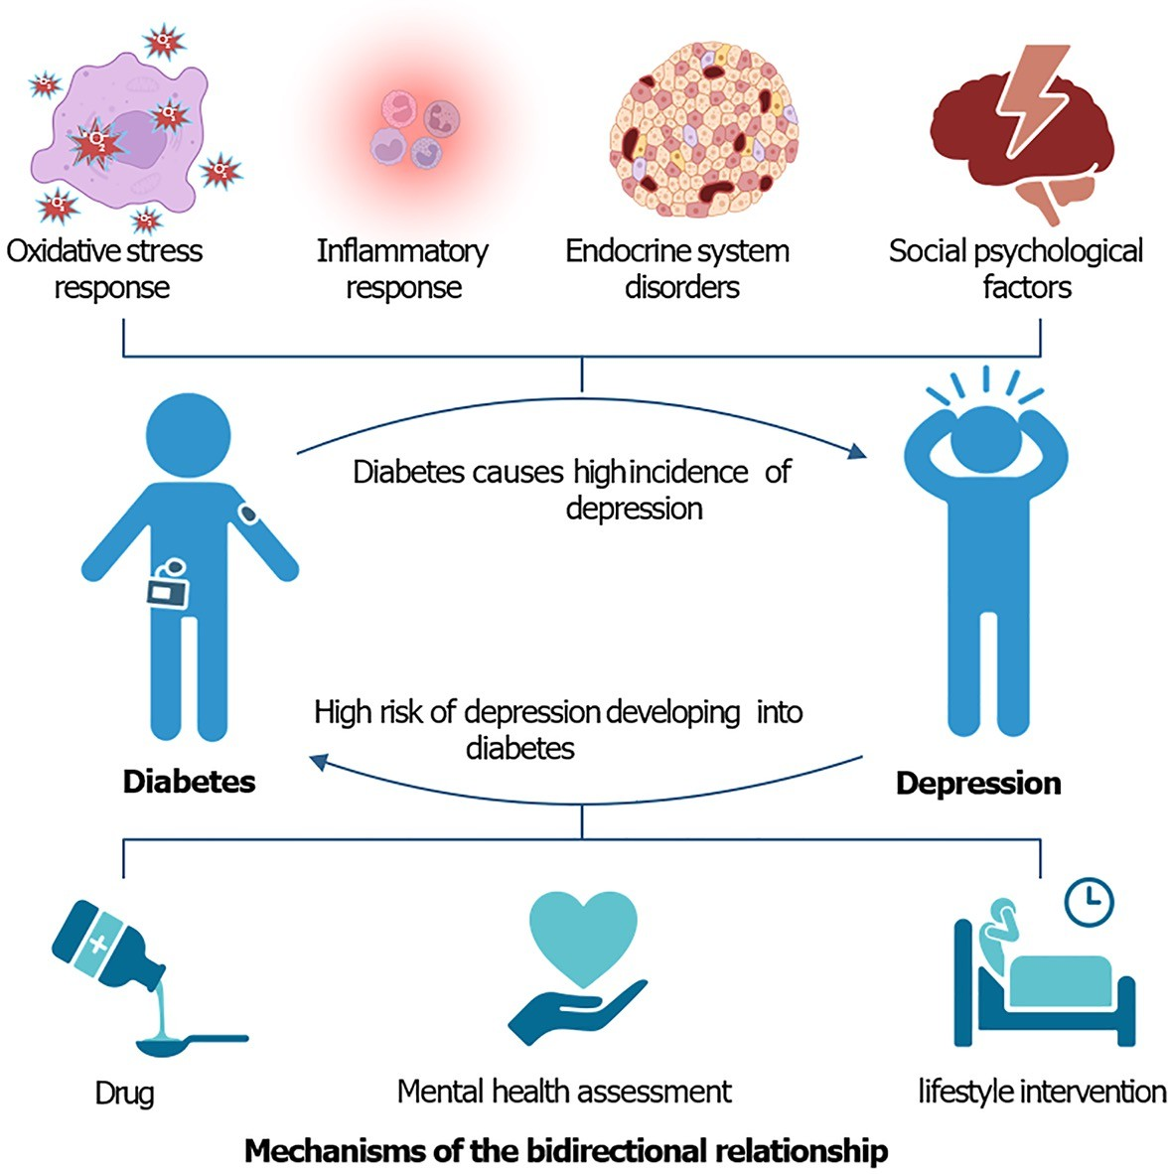
5/8/26
Facilitating Positive Heath Behaviors and Well-being to Improve Health Outcomes:
Standards of Care in Diabetes - 2025. Diabetes Care 2025;48(Suppl. 1):S86-S127
37
37
Diabetes and depression; a bidirectional relationship
World J Psychiatry. Oct 19, 2024; 14(10): 1429-
1436
Liu Y, Huang SY, Liu DL, Zeng XX, Pan XR, Peng
J. World J Psychiatry 2024; 14(10): 1429-1436 [PMID: 39474387 DOI: 10.5498/wjp.v14.i10.1429]
38

Slide 20
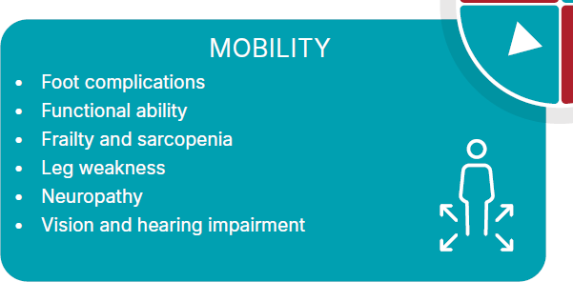
5/8/26
39
Diabetes and increased risk of falls
Diabetes mellitus is an independent fall risk factor among elderly nursing
home residents
Gait problem (OR = 1.8), balance difficulties (OR = 2.1), hypotension (OR = 1.7), and above three medications (OR = 1.55) were significantly
associated with a greater odd of having recurrent falls in a diabetes center
study
Peripheral neuropathy, decreased physical performance, decreased
cognitive performance, poor vision, and increased use of antidepressant
medication are also risk factors for falls
Maurer, M. S., Burcham, J., C Cheng, H. (2005). The journals of gerontology series A: biological sciences and medical sciences, C0(9), 1157-1162 Rashedi, V., Iranpour, A., Mohseni, M., C Borhaninejad, V. (2019). Diabetes & metabolic syndrome: clinical research & reviews, 13(4), 2347-2351.
40

Slide 21
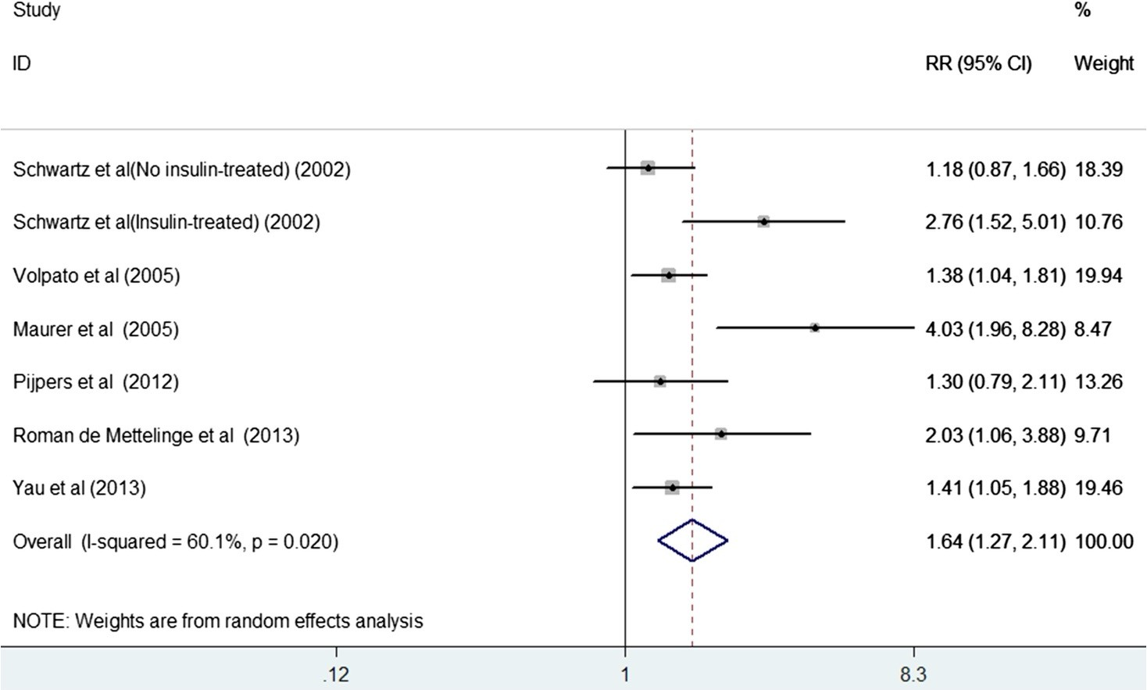

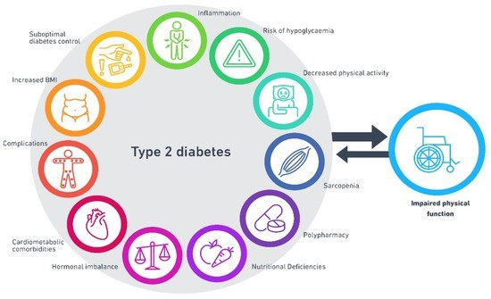
5/8/26
Forest plots showing RR and 95% CI of falls comparing the diabetic individuals to non-diabetes
Six studies involving 14,685 participants
The number of falls in diabetic and non-
diabetic individuals was 423 of 1,692 (25.0%) and
2,368 of 13,011 (18.2%),
respectively.
Diabetes was associated
with an increased risk of falls (risk ratio
[RR] = 1.64; 95%
confidence intervals [CI] 1.27–2.11)
.
Age Ageing, Volume 45, Issue 6, 2 November 2016, Pages 761–767, https://doi.org/10.1093/ageing/afw140
41
Mechanisms underpinning impaired physical function in T2D.
Ahmad, Seargent etal. Diabetology 2022, 3(1), 30-45; https://doi.org/10.33G0/diabetology3010003
42

Slide 22
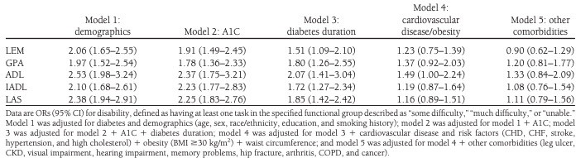
5/8/26
ORs for the association of diabetes and disability among older U.S. adults after adjustment for A1C, diabetes duration, and diabetes-related comorbidities, NHANES, 1999 –2004
43
Bone Health
  To reduce the risk of falls and fractures, glycemic management goals should be individualized for people with diabetes at a higher risk of fracture. C Prioritize use of glucose- lowering medications that are associated with low risk for hypoglycemia to avoid falls. B
  Advise people with diabetes on their intake of calcium (1,000–1,200 mg/day) and vitamin D to ensure it meets the recommended daily allowance for those at risk for fracture, either through their diet or supplemental means. B
  a Antiresorptive medications and osteoanabolic agents should be recommended for older adults with diabetes who are at higher risk of fracture, including those with low bone mineral density with a T-score ≤ -2.5, history of fragility fracture, or elevated Fracture Risk Assessment Tool score (≥3% for hip fracture or ≥20% for major osteoporotic fracture). B
4.13b Treatment may be considered for adults with diabetes with a T-score between −2.0 and
−2.5 in the presence of additional risk factors for fracture. C
44
44

Slide 23
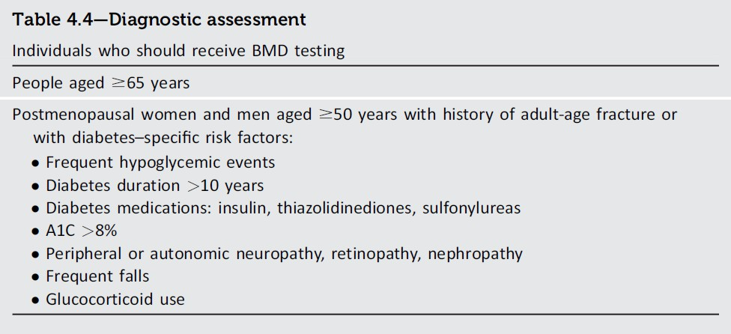
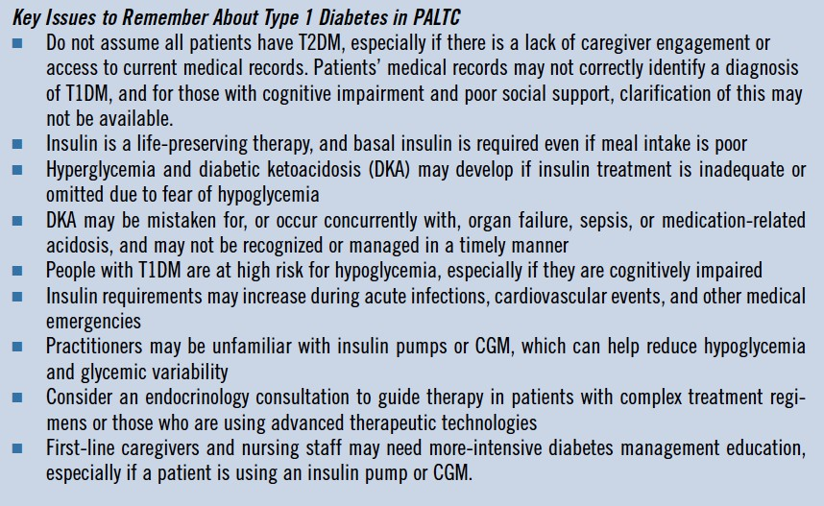
5/8/26
4. Comprehensive Medical Evaluation and Assessment of Comorbidities
Comprehensive Medical Evaluation and Assessment of Comorbidities:
Standards of Care in Diabetes - 2026. Diabetes Care 2026;49(Suppl. 1):S61-S88
45
45
46

Slide 24
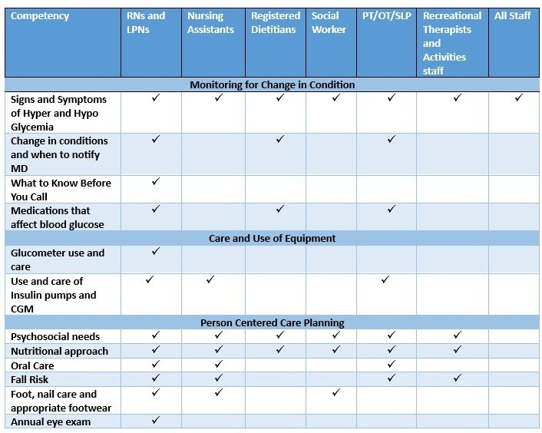







5/8/26
Interdisciplinary team roles-
Davidson, H. E., Pandya, N et al (2024). Clinical practice guideline for diabetes
management in the post-acute and long-term care setting. Journal of the American Medical Directors Association, 25(11), 105342.
Consultant pharmacist
47
Discussion
48

