Slide 1



5/8/26
Vaccines
Just the Facts Please
Christinia George, RPh, BCGP Guardian Pharmacy Atlanta
Christinia.George@GuardianPharmacy.net
1
Christinia George, RPh, BCGP
Christinia George is a Board-Certified Geriatric Pharmacist licensed in Georgia, Michigan and Indiana. Geriatrics has been a way of life as six grandparents and seven great grandparents were a major part of her childhood. While raising their three children, Christinia and her husband cared for an elderly family member for several years in their home. Christinia graduated from Purdue University School of Pharmacy, and has worked in retail, hospital, home infusion and long-term care. At Guardian Atlanta, she has worked as a staff pharmacist, a vaccinator and a consultant. Christinia enjoys helping families understand options they have and decisions they can make to improve the quality of life for elderly loved ones. Today’s presentation was inspired by the questions and comments from residents, families and staff during vaccination clinics.
2

Slide 2
5/8/26
Objectives
Discuss the importance of Herd Immunity and apply to vaccine clinic planning
Differentiate the different types of vaccines and impact on immunity
Evaluate the risk/benefit of vaccines
Review the current recommended vaccines for adult age 65+
3
Why Get Vaccinated?
Vaccine preventable diseases have not gone away
Vaccines help keep people healthy
Vaccine-preventable diseases can be debilitating or deadly
Vaccines are safer than the diseases they prevent
Vaccines do not cause disease
Vaccine-preventable diseases can be expensive
Most vaccine-preventable illness occurs in adults
“…vaccines save lives. They save the misery of diseases.”
Georges Benjamin, MD Executive Director of American Public Health Association
4

Slide 3
5/8/26
Types of Vaccines
Live, attenuated vaccines
Living pathogen that has been weakened in the lab
Produce a strong immune response giving long-lasting immunity
Not given to those age 65+ due to weaker immune systems
Examples: MMR, chickenpox, nasal flu vaccine
Inactivated vaccines
Pathogen has been killed in lab via heat, chemicals or radiation
Produce a weaker immune response thus need boosters
Safer for immunocompromised adults
Examples: injectable flu vaccine
Toxoid Vaccines
Chemically modified version of the toxin produced by the pathogen
Boosters needed to maintain enough circulating antibodies
Examples: diphtheria, tetanus
5
Types of Vaccines (continued)
Subunit
Uses a specific piece of the pathogen to trigger an immune response
aka recombinant, polysaccharide or conjugate
Adjuvants often added to boost the immune response
Examples: Pneumococcal, Shingles, Whooping cough
mRNA
Uses messenger RNA to instruct cells how to make a protein of the pathogen to trigger an immune response
Shorter manufacturing times
Research for mRNA vaccines began in early 1990s
mRNA vaccines have no contact with DNA in the cell
Examples: COVID, RSV
Future Potential Uses of mRNA Vaccines
Universal Influenza Vaccine
Personalized Cancer Vaccines (lung, pancreatic, colon, breast, melanoma)
HIV
Rabies
Auto-immune diseases
Tuberculosis
6

Slide 4
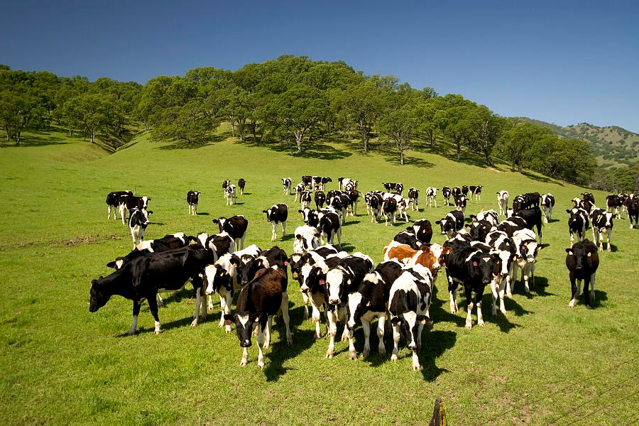
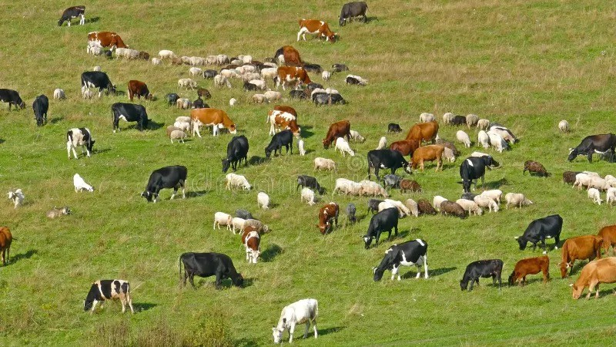
5/8/26
What is Herd Immunity?
Applies only for pathogens that are spread person to person, such as flu, COVID, RSV, & whooping cough
When the pathogen comes upon a person with immunity, the pathogen will stuggle
Herd Immunity is having enough people with immunity that a pathogen can’t spread easily.
Herd Immunity protects those who don’t have immunity due to other health issues.
7
Herd Immunity
8

Slide 5

5/8/26
Arrange for an inhouse vaccination clinic
Arrange transportation for residents to go out to local pharmacy or PCP office to get vaccinated
Provide VIS (Vaccine Information Statement) on vaccines – available on the CDC website
Provide education information on vaccine-preventable diseases and their vaccines-available on websites listed on Resource page
Educate staff on vaccines & how they help to prevent outbreaks
Talk with residents, families and staff about vaccine questions and concerns
Forward questions and concerns from residents & families about vaccines to your vaccinator or consultant
Ways to Achieve Herd Immunity
9
Poll Question 1
Which is a means by which the Wellness Director of Valley Manor Assisted Living can use the Herd Immunity concept to help prevent an outbreak of flu infections this coming winter?
A. Arrange to have an inhouse vaccination clinic for residents
B. Arrange an outing to a local pharmacy for residents to be vaccinated
C. Provide information on the flu vaccine to residents & families
D. All the above
10

Slide 6
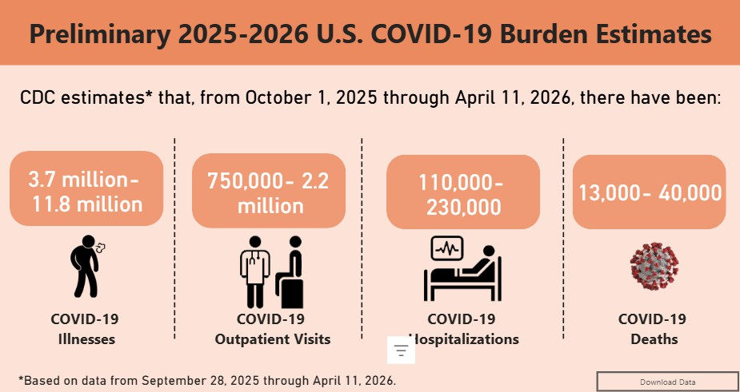
5/8/26
Poll Question 1 Answer
Which is a means by which the Wellness Director of Valley Manor Assisted Living can use the Herd Immunity concept to help prevent an outbreak of flu infections this coming winter?
A. Arrange to have an inhouse vaccination clinic for residents
B. Arrange an outing to a local pharmacy for residents to be vaccinated
C. Provide information on the flu vaccine to residents & families
D.
Answer: Herd Immunity is having enough people immune to a disease to prevent its spread. This protects the vulnerable individuals, those who cannot be vaccinated, from being exposed to the disease. Encouraging and enabling vaccination increases Herd Immunity. Thus, the correct answer is D.
All the above
11
2025-2026
Burden of
COVID-19 on
Entire Population
12

Slide 7
5/8/26
COVID-19
Side Effects: pain, redness & swelling at injection site, fatigue, headache, muscle pain, fever, nausea/vomiting
Recommendation: 1 dose in the fall and a 2nd dose 6 months later as COVID-19 infections surge in the winter and in the summer
VRBPAC, a vaccine advisory committee to the FDA, decides lineage of SARS-CoV-2 virus for the vaccine each year
Covered by Medicare Part B
Moderna (mRNA)
Pfizer-BioNTech (mRNA) Novavax (subunit)
13
Flu
Side Effects: pain, redness & swelling at injection site, headache, fever, muscle aches, nausea
Guillan-Barre Syndrome (weakness & paralysis throughout the body) rarely occurs after flu illness, but is more common after flu illness than after flu vaccination
Recommended 1 dose every year before flu season
Studies showing flu vaccine significantly decreased risk for Alzheimer’s Disease (Neurology April 1, 2026)
Covered by Medicare Part B
Fluzone HD Flublok (egg free) Fluad (adjuvant)
14

Slide 8
5/8/26
Poll Question 2
The Wellness Director of Valley Manor Assisted Living contacts you. The residents are asking her what side effects they may experience from the flu and/or COVID vaccines at the upcoming inhouse vaccination clinic. What do you tell her?
A. Side effects resolve in 1-3 days and are generally mild to moderate
B. They may have redness, pain & swelling at the injection site
C. They may experience body aches, headache, and/or fever
D. All the above
15
Poll Question 2 Answer
The Wellness Director of Valley Manor Assisted Living contacts you. The residents are asking her what side effects they may experience from the flu and/or COVID vaccines at the upcoming inhouse vaccination clinic. What do you tell her?
A. effects resolve in 1-3 days and are generally mild to moderate
B. They may have redness, pain & swelling at the injection site
C. They may experience body aches, headache, and/or fever
D.
Answer: After any injectable vaccine, there can be redness, pain and swelling at the injection site. Flu and COVID vaccine side effects are very similar, including headache, fever, and muscle aches.
Side effects tend to be mild to moderate and resolve in 1-3 days most often. Thus, the correct answer
is D.
All the above
16

Slide 9
5/8/26
There are more than 100 serotypes of pneumococcal bacteria
They cause pneumonia, meningitis, bacteremia, sinusitis and otitis media
Recommendations are dependent on individual’s previous pneumococcal vaccination history
PneumoRecs VaxAdvisor (free app for iOS & Android or web-based version) to quickly determine patient specific recommendation
Side Effects: pain, redness & swelling at injection site, fatigue, headache, muscle aches, joint pain, loss of appetite, chills
Covered Medicare Part B
Pneumococcal
PCV21(Capvaxive) PCV20 (Prevnar 20) PCV15 (Vaxneuvance) PPSV23 (Pneumovax 23)
17
RSV
(Respiratory Syncytial Virus)
Side Effects: Pain, redness & swelling at injection site, fatigue, headache, muscle & joint pain, nausea
Recommended: 1 dose for adults aged 75 and older, 1 dose for adults age 60-74 years with a risk factor. Risk factors include reside in a nursing home, cardiovascular disease, chronic lung or respiratory disease, diabetes, obesity, chronic liver disease, and others
One time dose, best given in late summer/early fall just before RSV season but can be given anytime of year. Vaccines are being monitored for how long immunity lasts and if adults would need a 2nd dose in the future.
Covered Medicare Part D
Arexvy (subunit) mResvia (mRNA) Abrysvo (subunit)
18

Slide 10
5/8/26
Shingles illness is a painful, itchy rash that follows a nerve, may also have fever, headache, fatigue & light sensitivity. The nerve pain can be long-term, severe & debilitating.
Side Effects: pain, redness & swelling at injection site, sore arm, tiredness, muscle pain, headache, shivering, fever, stomach pain, nausea – these usually last 2-3 days due to strong immune response
Recommended: 2 doses, separated by 2 to 6 months
Can receive regardless of past chickenpox illness or vaccine
Can receive if had Zostavax vaccine (no longer available)
Can receive if have had shingles (wait till rash is gone)
Studies indicate shingles vaccine may decrease risk of dementia, as well as slow dementia. (med.stanford.edu/news/all- news/2025/03/shingles-vaccination-dementia.html)(npj Vaccines 10,
130 (2025). https://doi.org/10.1038/s41541-025-01172-3)
Covered Medicare Part D
Shingles
Shingrix (subunit)
19
Tetanus causes painful stiffening of muscle, including difficulty breathing, swallowing or opening mouth. Diphtheria can cause difficulty breathing, heart failure & paralysis. Pertussis, aka “whooping cough”, makes breathing, eating & drinking difficult. In adults, it can cause loss of bladder control, passing out and rib fractures from coughing.
Recommendation: 1 dose every 10 years, or after 5 years if have a severe wound or burn
Side Effects: pain, redness & swelling at injection site, fever, headache, fatigue, nausea, vomiting, diarrhea
Adults are most common source of whooping cough which can be deadly to infants.
Between 2009-2023, women aged 80 and up had the highest incidence of tetanus
Covered Medicare Part D
Tdap (Tetanus, Diphtheria, Pertussis)
20

Slide 11
5/8/26
Poll Question 3
A new resident of Valley Manor Assisted Living asks if he should get any vaccines now that he is living no longer living on his own. He tells you he is 71 years old, had measles as a child but doesn’t know about chickenpox, has had both flu and COVID vaccines the past few years, has high cholesterol, high blood pressure and is recovering from a broken ankle. What vaccines might he be eligible to receive?
A. RSV, Shingles, Tdap
B. Pneumococcal, Chicken Pox, Flu
C. Flu, MMR, COVID
D. COVID, MMR, RSV
21
Poll Question 3 Answer
A new resident of Valley Manor Assisted Living asks if he should get any vaccines now that he is living no longer living on his own. He tells you he is 71 years old, had measles as a child but doesn’t know about chickenpox, has had both flu and COVID vaccines the past few years, has high cholesterol, high blood pressure and is recovering from a broken ankle. What vaccines might he be eligible to receive?
A.
B. Pneumococcal, Chicken Pox, Flu
C. Flu, MMR, COVID
D. COVID, MMR, RSV
Answer: RSV because he lives in a nursing home. Shingles & Pneumococcal due to his age. Tdap as he doesn’t mention having had, so most likely has been 10 years since his last dose. Flu & COVID due to chronic health conditions and living in close proximity to others. He had measles as a child & was born prior to 1957, thus would not need MMR. He was born before 1980, so does not need chickenpox but would be at risk for shingles. Thus, the correct answer is A.
RSV, Shingles, Tdap
22

Slide 12
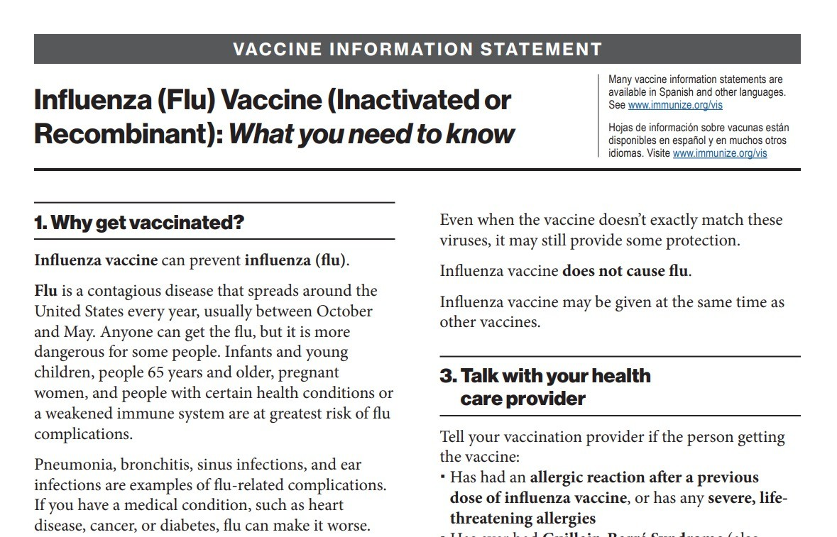
5/8/26
Resources
CDC.gov US Centers for Disease Control and Prevention
CIDRAP.UMN.edu Center for Infectious Disease Research and Policy
NFID.org National Foundation for Infectious Diseases
Immunize.org Vaccine education materials for healthcare professionals
VaccineInformation.org Vaccine education materials for residents and their families
23
24

Slide 13
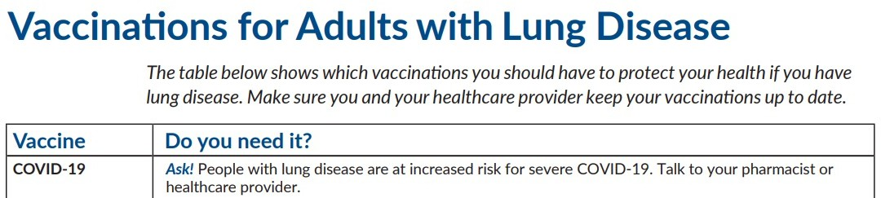
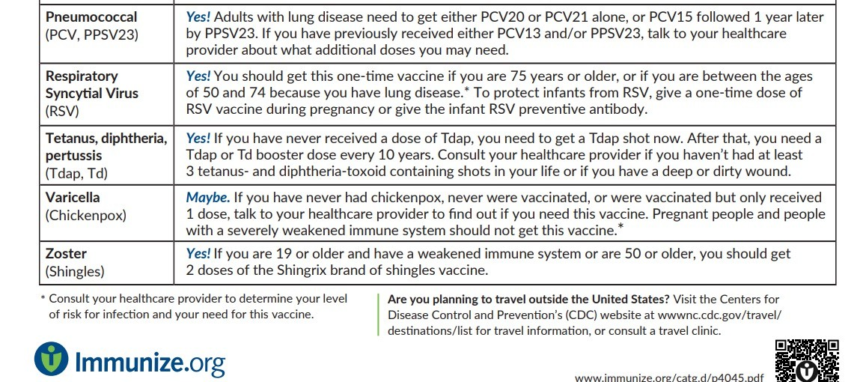
5/8/26
25
Question 1
Mary Russell, aged 79, lives in Valley Manor Assisted Living. She has type 2 diabetes, asthma, osteoarthritis, and anemia. She wants to stay healthy but heard from a friend that vaccines could give her the disease because they contain the live pathogen. Which vaccines can she safely receive?
A. Nasal Flu vaccine, Covid vaccine, Shingles vaccine
B. Injectable Flu vaccine, Pneumococcal vaccine, Tdap vaccine
C. Covid vaccine, MMR vaccine, Chickenpox vaccine
D. Injectable Flu vaccine, MMR vaccine, Chickenpox vaccine
26

Slide 14
5/8/26
Question 1 Answer
Mary Russell, aged 79, lives in Valley Manor Assisted Living. She has type 2 diabetes, asthma, osteoarthritis, and anemia. She wants to stay healthy but heard from a friend that vaccines could give her the disease because they contain the live pathogen. Which vaccines can she safely receive?
A. Nasal Flu vaccine, Covid vaccine, Shingles vaccine
B.
C. Covid vaccine, MMR vaccine, Chickenpox vaccine
D. Injectable Flu vaccine, MMR vaccine, Chickenpox vaccine
Answer: Due to her age, she should not receive any live, attenuated vaccines. The Nasal Flu vaccine, MMR vaccine and Chickenpox vaccine are all live, attenuated vaccines. Thus, only B is the correct answer.
Injectable Flu vaccine, Pneumococcal vaccine, Tdap vaccine
27
Question 2
John Waltman, aged 69, lives in Valley Manor Assisted Living and wants to get the Shingles vaccine. He has heard that the shingles infection can be quite painful and he doesn’t want to experience it. He thinks he had chickenpox as a child but isn’t certain. Can he get the Shingles vaccine?
A. Yes, but only if can find confirmation that he had chickenpox as a child
B. No as he is not old enough for the Shingles vaccine
C. Yes, as documentation of previous chickenpox vaccine or infection is not necessary
D. No as must live in a house in the countryside
28

Slide 15
5/8/26
Question 2 Answer
John Waltman, aged 69, lives in Valley Manor Assisted Living and wants to get the Shingles vaccine. He has heard that the shingles infection can be quite painful and he doesn’t want to experience it. He thinks he had chickenpox as a child but isn’t certain. Can he get the Shingles vaccine?
A. Yes, but only if can find confirmation that he had chickenpox as a child
B. No as he is not old enough for the Shingles vaccine
C.
D. No as must live in a house in the countryside
Answer: The Shingles vaccine is recommended for those age 50 and older. It is a 2-dose series, given 2 to 6 months apart, regardless of one’s history with either the chickenpox disease or vaccine. Thus, the correct answer is C.
Yes, as documentation of previous chickenpox vaccine or infection is not necessary
29
Question 3
Which of the following vaccine types are NOT given to seniors due to their weakened immune systems?
A. mRNA vaccines such as COVID & RSV vaccines
B. inactivated vaccines such as injected flu vaccines
C. toxoid vaccines such as diphtheria & tetanus vaccines
D. live, attenuated vaccines such as measle, mumps & chickenpox vaccines
30

Slide 16
5/8/26
Question 3Answer
Which of the following vaccine types are NOT given to seniors due to their weakened immune systems?
A. mRNA vaccines such as COVID & RSV vaccines
B. inactivated vaccines such as injected flu vaccines
C. Which toxoid vaccines such as diphtheria & tetanus vaccines
D.
Answer: Live, attenuated vaccines are not recommended for seniors. Toxoid vaccines, Inactivated vaccines and mRNA vaccines are given to seniors. Thus, the correct answer is D.
live, attenuated vaccines such as measle, mumps & chickenpox vaccines
31
Question 4
While waiting for his turn at Valley Manor Assisted Living’s vaccine clinic, Morris Vandiver, aged 72, tells you he had an RSV and Tdap vaccine last month at the doctor’s office. He asks if he needs another RSV and Tdap, and can he still get his flu and COVID vaccines today. What do you tell him?
A. RSV vaccine is a single dose. At his young age, he was eligible for it because of residing in an assisted living facility.
B. Tdap vaccine is one dose every 10 years, unless he gets a serious wound and it has been more than 5 years since his last Tdap vaccine.
C. Yes, he can receive both his flu and COVID vaccine today.
D. All the above
32

Slide 17
5/8/26
Question 4 Answer
While waiting for his turn at Valley Manor Assisted Living’s vaccine clinic, Morris Vandiver, aged 72, tells you he had an RSV and Tdap vaccine last month at the doctor’s office. He asks if he needs another RSV and Tdap, and can he still get his flu and COVID vaccines today. What do you tell him?
A. RSV vaccine is a single dose. At his young age, he was eligible for it because of residing in an assisted living facility.
B. Tdap vaccine is one dose every 10 years. Unless he gets a serious wound and it has been more than 5 years since his last Tdap vaccine.
C. Yes, he can receive both his flu and COVID vaccine today.
D.
Answer: RSV vaccine is recommended for anyone age 60 and older living in a nursing home. Tdap is recommended to be repeated every 10 years. If one receives a moderate to severe wound and it has been more than 5 years since last dose, Tdap should be repeated. Countless studies support receiving flu and COVID vaccines at the same time. Thus, the correct answer is D.
All the above
33
34

Slide 18
5/8/26
35
36

Slide 19
5/8/26
37
38

