Slide 1



5/8/26
Using Medication Parameters to Improve Medication Safety
Cera Roberts, PharmD
Age-Friendly Clinical Consultant Pharmacist Guardian Pharmacy of the Heartland
Susan Franken, LPN/BSHM
Nurse Account Manager, Supervisor – Kansas Guardian Pharmacy of the Heartland
1
Disclosures
The content within this presentation is provided only for informational purposes. The presenters attempt to ensure that all data and information within the presentation’s contents are accurate and obtained from reliable sources but does not represent it to be error-free.
The content and information provided in this presentation is not intended or implied to be a substitute for professional medical advice, diagnosis, and/or treatment. Always seek the advice of a physician or other qualified healthcare provider with any questions regarding a medical condition. Never disregard professional medical advice or delay in seeking it because of information located within this presentation.
This presentation contains multiple overviews for a variety of Long-Term Care facility statutes and regulations. The information regarding these regulations is not all-inclusive and should not be substituted for legal advice or guidance with respect to regulatory compliance for a nursing facility.
This presentation contains Microsoft Office Copilot AI generated images.
2

Slide 2

5/8/26
Objectives
Identify types of medication parameters and define professionally accepted ranges to support safe medication administration
Assess parameter requirements and monitoring frequency based on level of care and availability of qualified staff
Utilize facility protocols and staff observations to recognize when medication parameters should be initiated
Interpret parameter findings to guide medication administration decisions and communicate findings to the designated team member to ensure appropriate follow-up actions
3
Identify Types of Parameters
4

Slide 3
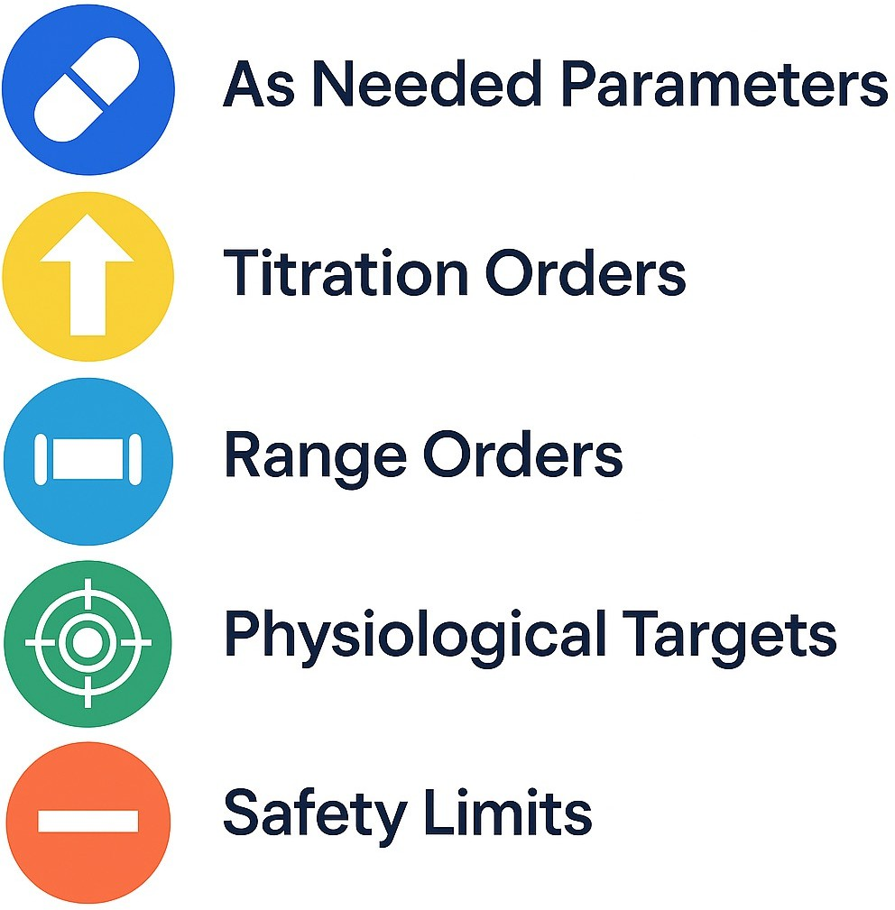


5/8/26
Types of Medication Parameters
5
Administration Parameters
As Needed Parameters
Titration Orders
Range Orders
Safety Limits
6

Slide 4












Physiological Parameters
5/8/26
Weight¹ Pulse/Heart Rate⁴
BMI: 18.5 – 25 kg/m² • Resting Heart Rate: 60 – 100 beats/minute
Blood Sugar Values²
A1c: < 5.7%
Fasting Plasma Glucose: < 100mg/dL
Pain Score^{5 •}
7-9: Severe
0 = No pain
1-3: Mild pain
4-6: Moderate
10: Worst pain possible
Respiratory Rate³
Resting Respiratory Rate: 12 – 20 breaths per minute
Blood Pressure⁶
SBP/DBP: < 120/ < 80
7
When to Utilize Medication Parameters
8

Slide 5

Who Dictates Your Facility’s Parameter Policies?
5/8/26
9
Factors for Parameter Regulations
Legal Oversight
Environmental Influences
Federal Regulation
Examples: FDA, CDC, HHS, DEA, etc…
Corporation Policies
State Regulation
Example: Local state Department for Aging and Disability Services
Facility Location
Rural vs. City Setting
Staffing
Number of available or required staffing levels
Facility Accreditation
Examples: The Joint Commission, CMS, etc…
Trained Level of Staff
RN/LPN vs. CMA vs CNA
10

Slide 6







5/8/26
11
Utilizing Administration Parameters
As Needed Range Titration Safety Parameters Parameters Parameters Parameters
12

Slide 7

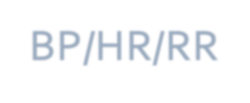








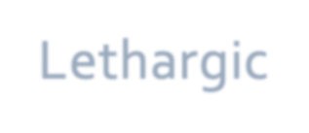
5/8/26
Common Indications Appropriate for Physiological Parameters
Headaches
BP/HR/RR
Dizziness
Sweaty Palms
BS
Unsteady Gait
Drowsiness
PAIN
Lethargic
13
Utilizing Physiological Parameters
Location
Legal Regulations
Qualified Staff
Physiologic Parameter Factors
Resident Capability
Staffing Ratio
Corporate Policy
14

Slide 8
Documenting Parameter Utilization and Outcomes
5/8/26
15
Documentation! Documentation! Documentation!
Implementation
Who identified the need for the parameter?
Who initiated the parameter protocol?
Has the need for the parameter been discussed and approved by the resident?
Who is qualified to complete the parameter?
Parameter Outcome(s)
Who documents the parameter outcome? And where is the outcome documented?
Who is notified of parameter outcomes when the protocol requires a clinical evaluation or decision?
Next Steps/Follow up
What interventions took place because of the parameter outcome?
If the intervention required clinical evaluation, who evaluated the outcome? Did they document their decision- making rationale?
When should the parameter be re-evaluated for appropriateness?
16

Slide 9
Communication Beyond Documentation
5/8/26
17
Intake
CQI
Meetings
Initiation
Communication is Key
Follow Up
Outcome
18

Slide 10
Self-Assessment Questions
5/8/26
19
Patient Case Scenario – Mr. TS
Patient History:
Mr. T Swift is an 87 yo M currently residing in Arrowhead Drive assisted nursing facility. The facility’s provider is in today to address Mr. Swift’s recent fall that sent him to the ER and to assess staff reports of increased episodes of confusion and disorientation. Mr. Swift reports he is worried that he will fall again as he feels unsteady on his feet.
Past Medical History:
2 Falls within the last 30 days; 1 fall with injury.
Hypertension (HTN)
Insomnia (INS)
Osteoarthritis (OA) Vitals from today:
BP: 102/54
HR: 65
Pain (1-10): 6
Weight: 189 lbs
Current Medications:
Amlodipine 5mg – HTN
Zolpidem 10mg – INS
Furosemide 40mg – HTN/EDEMA
Meloxicam 7.5mg – OA
Tramadol 50mg – Pain (Fall)
Acetaminophen 650mg – Pain (Fall)
Diphenhydramine 25mg - INS
20

Slide 11
5/8/26
Which of Mr. Swift’s available vitals is a subjective physiological parameter?
Weight
Blood Pressure
Pain Score
Heart Rate
None of the Above
21
Which of Mr. Swift’s medication orders is NOT correctly paired with their administrative parameter?
Acetaminophen 650mg ER Give one tablet by mouth every 6 hours for pain; NTE 3G of Acetaminophen per day – Safety Parameter
Benadryl 25mg Give one to two tablets by mouth every night at bedtime as needed for insomnia – Range Parameter
Tramadol 50mg Give one tablet by mouth every 6 hours as needed for severe pain (7-10) – As Needed Parameter
Meloxicam 15mg Give one tablet by mouth daily for increase pain for 14 days then decrease to routine Meloxicam order of 7.5mg daily – Range Parameter
None of the above
22

Slide 12
5/8/26
Given Mr. Swift’s recent history of falls, which of the following medication parameters would be most appropriate to consider starting?
A.Blood Pressure B.Respiratory Rate C.Weight
D.Pain Score Evaluation
E.None of the Above
23
Before we can initiate Mr. Swift’s blood pressure parameters, which of the following circumstances will have the MOST impact on the frequency of the parameter?
A.Facility Location
B.Facility License/Registration C.Corporate Policy/Procedure
D.Mr. Swift’s Consent for the Parameter E.Availability of Trained Staff
24

Slide 13
5/8/26
After starting bi-weekly and as needed blood pressure monitoring for Mr. Swift, you have the following results. What documentation step would BEST define these results ?
Week 1: 107/84, 102/55 Week 2: 100/59, 115/75 Week 3: 113/72, 103/54 Week 4: 106/50, 103/63
Implementation
Parameter Outcome(s)
Next Steps/Follow Up
None of the Above
25
Questions?
26

Slide 14
5/8/26
Resources
American Heart Association. Body Mass Index (BMI) In Adults. www.heart.org. Published 2024. https://www.heart.org/en/healthy-living/healthy-eating/losing-weight/bmi-in-adults
American Diabetes Association. Understanding diabetes diagnosis. American Diabetes Association. Published 2023. https://diabetes.org/about-diabetes/diagnosis
American Lung Association. Understanding Vital Signs: The Importance of Your Respiratory Rate. Lung.org. Published 2025. https://www.lung.org/blog/respiratory-rate-vital-signs
American Heart Association. Target Heart Rates Chart. American Heart Association. Published August 12, 2024. https://www.heart.org/en/healthy-living/fitness/fitness-basics/target-heart-rates
Dydyk AM, Grandhe S. Pain Assessment. PubMed. Published 2025. https://www.ncbi.nlm.nih.gov/books/NBK556098/
Monitoring Your Blood Pressure at Home. www.heart.org. Published 2025. Accessed April 23, 2026. https://www.heart.org/en/health-topics/high-blood-pressure/understanding-blood-pressure- readings/monitoring-your-blood-pressure-at-home
27
Using Medication Parameters to Improve Medication Safety
Cera Roberts, PharmD
Age-Friendly Clinical Consultant Pharmacist Guardian Pharmacy of the Heartland
Susan Franken, LPN/BSHM
Nurse Account Manager, Supervisor – Kansas Guardian Pharmacy of the Heartland
28

